Slide 1
AI Tools for Onsite Operations
How to get the most out of our AI assistant
Notes:
Audience: Operations leadership at PMCs will share these materials with their middle-managers. In turn, managers will train centralized and onsite teams on proper deployment and use of AI tools.

Slide 2
Why Embrace New Tech?

Slide 3
CHANGE MANAGEMENT
Why Embrace New AI Tools?
Combat burnout & prioritize career development
Respond to changing consumer demands
Remain competitive in an evolving marketplace
Improve resident experience & property performance
Notes:
AI will free you from the mundane tasks that keep you from reaching your full potential. Most of you will not remain in your current role forever. We want to show you how to leverage AI tools to open career opportunities. Example: Maintenance Tech grows into Quality Control Monitor.
Pro tip: EliseAI grants AI education certification for employees to share with their professional networks.
The modern consumer - whether they are requesting an Uber or hunting for an apartment - expects immediate responsiveness and 24/7 coverage. We cannot expect our teams to meet that expectation (without help).
All of our competitors are using AI in some way or another. We risk falling behind if we do not embrace change now.
Ultimately, we know these tools will make your lives easier. In turn, you will elevate the resident experience at every stage of the customer lifecycle.

Slide 4
CHANGE MANAGEMENT
Challenges We Face
Real feedback from centralized and onsite teams
“After-hours lead volume now exceeds inbound traffic during business hours. Team members complain about stale leads when they look at their queues every morning. Leads ghost us when they don’t receive immediate attention.”
“How are we expected to retain top employees if we ask them to make hundreds of collections calls and rent reminders every week? Frequent unpleasant conversations lead to rapid burnout and high turnover.”
“My techs spend too much time gathering information and not enough time solving work orders. How can we limit the time-consuming back-and-forth between residents and techs?”
Terry V.
Community Manager
Sandra M.
AR Manager
Mike S.
Maintenance Supervisor

Slide 5
CHANGE MANAGEMENT
Understanding AI Capabilities
Chatbot
Your AI Assistant
Generative AI
Provides coherent, context-aware responses that keep conversations flowing.
A conversational system using generative models that enable richer dialogues.
Creates original content and identifies patterns from massive datasets.
Well defined knowledge boundaries
Tailored to specific objectives. Constantly learning.
Fewer constraints on structure or content.
AI will not replace the human touch. However, it will free you from the mundane tasks that keep onsite and centralized employees from reaching their full potential. AI will not replace you. It will empower you.

Slide 6
CHANGE MANAGEMENT
Common Misconceptions
AI Only Supports Struggling Communities
Implementing AI Tools Will Create More Work
AI is Making Things Up
Your AI assistant will provide a lift to all communities, even top-performers & distressed assets.
With the proper initial investment, your AI assistant will reduce workloads – especially the time-consuming, repetitive tasks.
You set the guardrails. Initially, AI may expose gaps in the information you feed it. Treat these gaps as opportunities for progress.

Slide 7
CHANGE MANAGEMENT
Train Your AI Like a New Hire
Prepare For Onboarding Build an onboarding roadmap and stick to it
Flag Errors, Make Corrections AI will not make the same mistake twice
Standardize Policies Provide standard reference frameworks
Educate Your AI Feed your AI maximum, accurate knowledge
Invest in Your AI Invest your time to understand how it works
Be Patient Learning takes time. AI will grow with you

Slide 8
AI for Onsite Operations

Slide 9
SOLUTIONS
The Only End-to-End Renter Platform
Voice
Email
Text
Chat
Leasing
Answer, qualify, and schedule tours for all leads.
Maintenance Requests
Track and ticket resident work orders.
Delinquency
Remind renters of & track all on-time and late payments.
Lease Renewals
Automate & inform residents of upcoming lease renewals.
Notes:
Leverage AI to improve efficiency across every stage of the customer journey

Slide 10
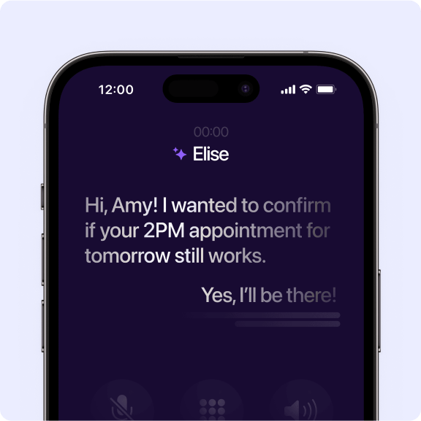
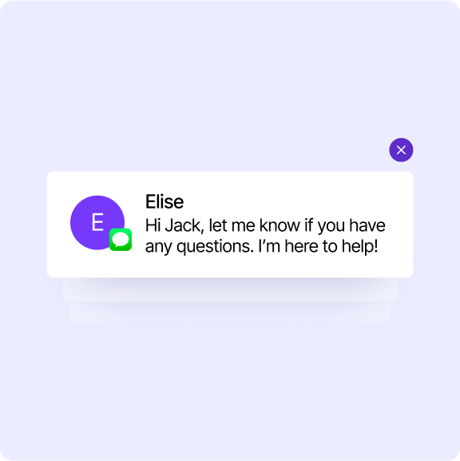
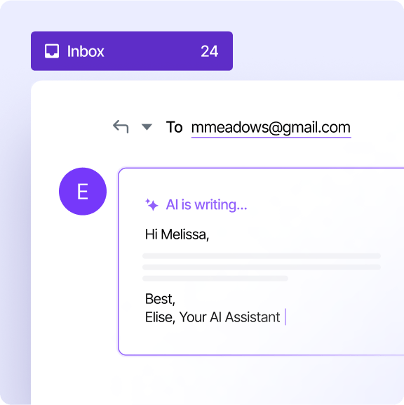
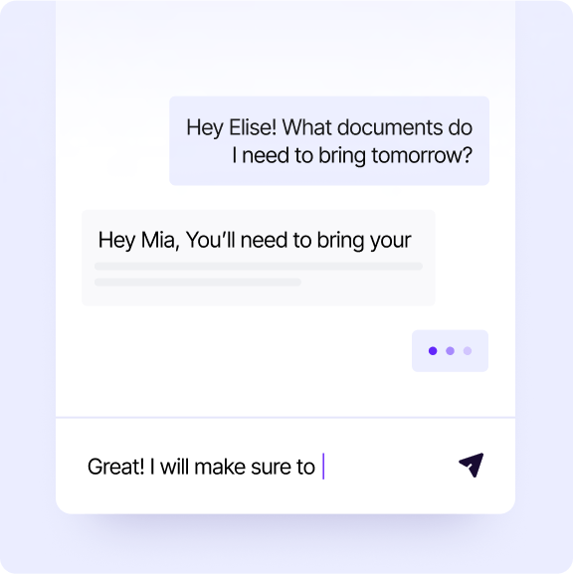
SOLUTION
Omni Channel Support
Voice
Answers calls 24/7 with no hold time and can even make outbound calls.
Text
Reaches out via SMS, making communications easy, even on-the-go.
Email
Manages inboxes, responds to incoming messages and can handle following up.
Chat
Responds to requests from prospects and residents right from your website.

Slide 11
AI Solutions Allow You to Focus on the Tasks That Matter Most
1
Conducting tours
Closing sales
Supervising vendors
Building relationships with prospects and residents
Planning for future challenges
2
3
4
5

Slide 12
AI for Leasing

Slide 13
AI SUPPORTED LEASING
Overcoming Leasing Challenges
Challenge
How AI Can Assist
After-hours calls, texts, emails, and web chats
Delayed tour follow-up messages
Overwhelming lead volume
Unqualified leads
Frequent tour cancellations
Inaccurate and inconsistent information
AI ensures 24/7 responsiveness, keeping leads warm and engaged
AI sends post-tour materials, so you can focus on the next prospect
AI serves as your scheduling assistant – no more back-and-forths
AI asks qualifying questions and routes leads intelligently
AI reminds prospects about upcoming tour commitments
AI is learning constantly and will not provide information beyond its scope
AI-supported leasing unlocks more tours, higher quality tours, faster conversions, and ultimately, bigger leasing bonuses and happier residents.

Slide 14
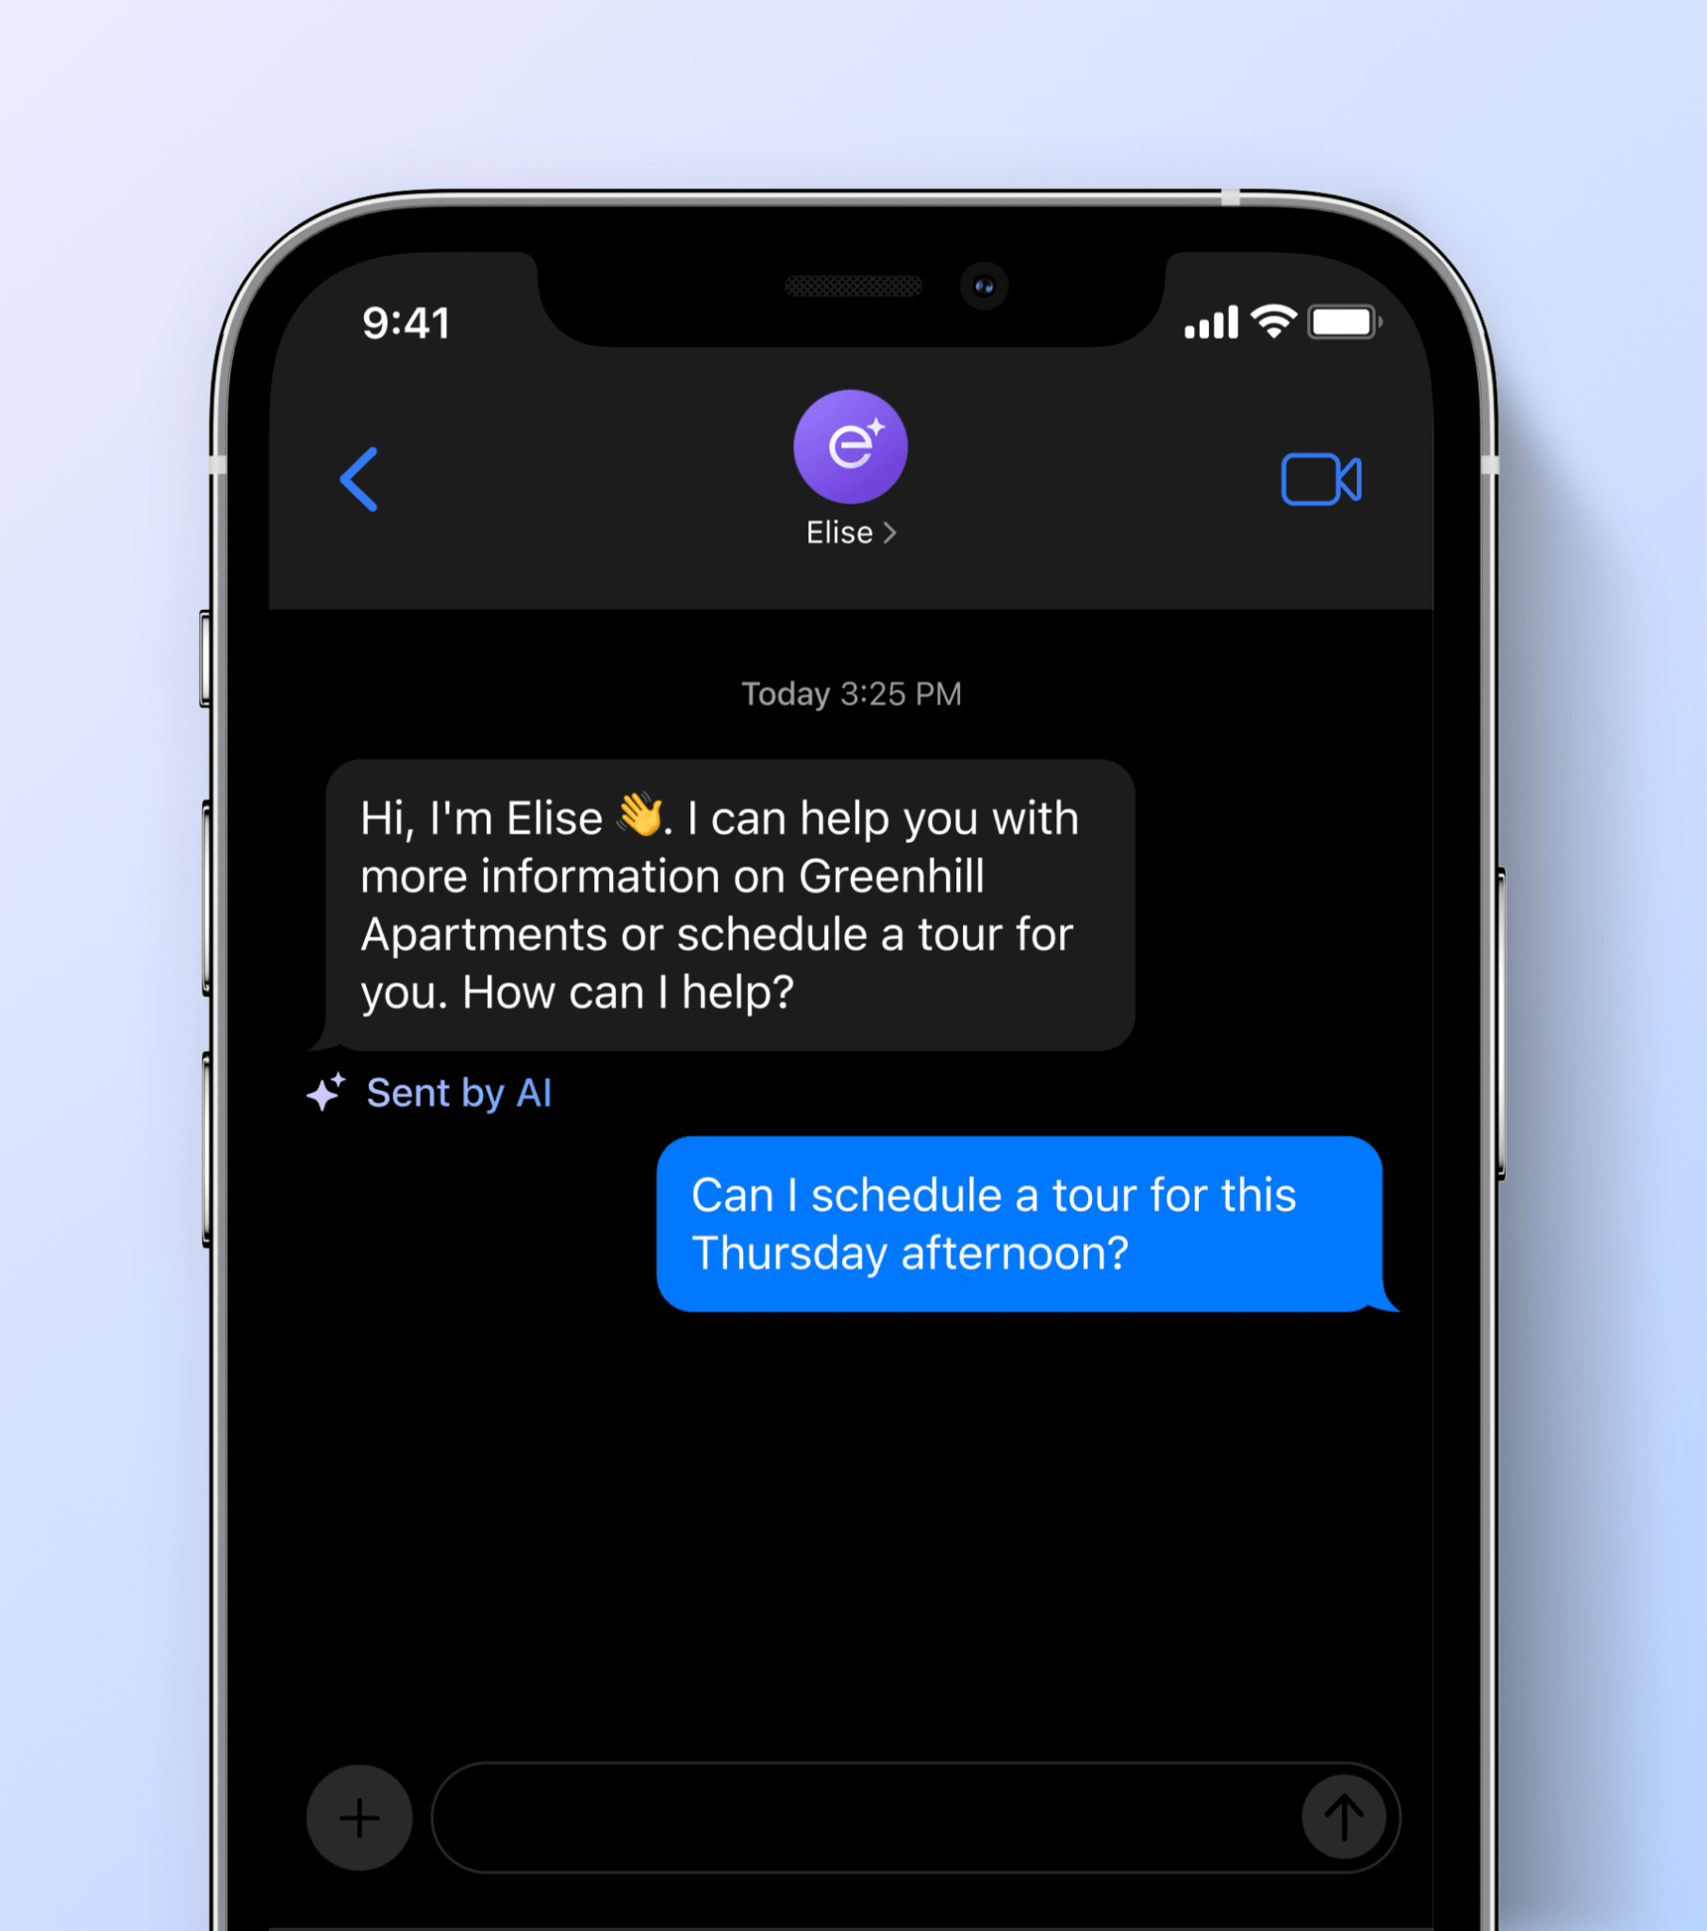
LEASINGAI
Lead Management
Your AI assistant responds to all new prospects and keeps them engaged with consistent follow-ups to match your preferred follow-up schedule.
24/7 responses across webchat, email, text, and VoiceAI AI responds within 5 minutes to keep leads warm and reduce lead unresponsiveness Answers questions about unit availability and pricing, amenities, and community guidelines Nurtures prospects during their leasing journey to keep them informed and engaged

Slide 15
LEASINGAI
Customizable Follow-Up Cadence
AI can replicate our existing follow-up schedule to ensure timely responses and follow-up with prospects to improve the lead-to-lease timeline for more efficient leasing.
Tour Booked
Application Submitted
New Lead
Tour
Application Started
Application Approved
Follow-ups
Mark Completed
No Show or Future
Follow-ups
Response
Immediate
1 day
Immediate
Immediate
Started
Immediate
2 day
Complete
Immediate
2 days
2 days
2 days
5 days
Confirmation
Immediate
7 days
6 days
6 days
12 days
Approved
Immediate
60 days
12 days
12 days
20 days
Reminder
1 day
30 days
Move-in Date
Move-in Date
90 days
90 days
60 days
60 days
30 days
30 days
Follow-up is immediate
14 days
14 days
Follow-up is prior to action
Move-in
Move-in
Follow-up is post action
300 days
300 days

Slide 16
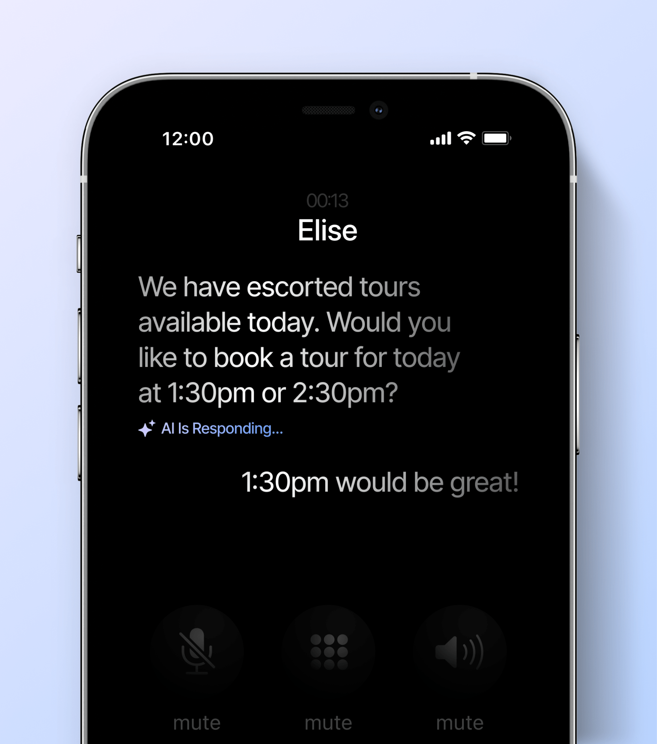
LEASINGAI
Receives Inbound Calls
EliseAI can answer calls from prospects 24/7 with VoiceAI.
Schedules tours across all your properties based on calendar availability. Answers questions about pricing, amenities, community policies, local transportation, and more. Operates 24 hours a day, 7 days a week so you never miss a lead, even during your peak hours. Proactively calls leads who have been unresponsive to scheduling a tour. Currently speaks English, Spanish, German, Polish, Italian, French, Portuguese.
→ View Demo

Slide 17
What This Means for You
Role
Impact From AI Support
Leasing Agent
Increased tour volume; more time to focus on customer relationships and objection-handling
Marketing Manager
Lower marketing spend; reduced CAC; fewer neglected leads; less uncertainty
Community Manager
Accelerated leasing; reduced vacancy loss; lower employee turnover; fewer scheduling headaches
Regional Manager
Thicker margins; new revenue opportunities; more predictable payroll expenses

Slide 18
AI for Collections

Slide 19
AI SUPPORTED COLLECTIONS
Overcoming Collections Challenges
Challenge
How AI Can Assist
Unresponsive residents carrying a balance
Inaccurate and incomplete delinquency notes
Complicated payment plan management
Improper collections protocols
AI expands your ability to send frequent, omnichannel touchpoints
AI saves a record of every phone, text, email, and chat conversation
AI makes it easy to set up payment plans and handles reminders
AI scores calls to ensure agents are not violating SOPs
AI-supported collections unlocks increased collections rates, accelerated collections, greater visibility into delinquent resident interactions , and ultimately, less bad debt and fewer burnt-out AR managers.

Slide 20
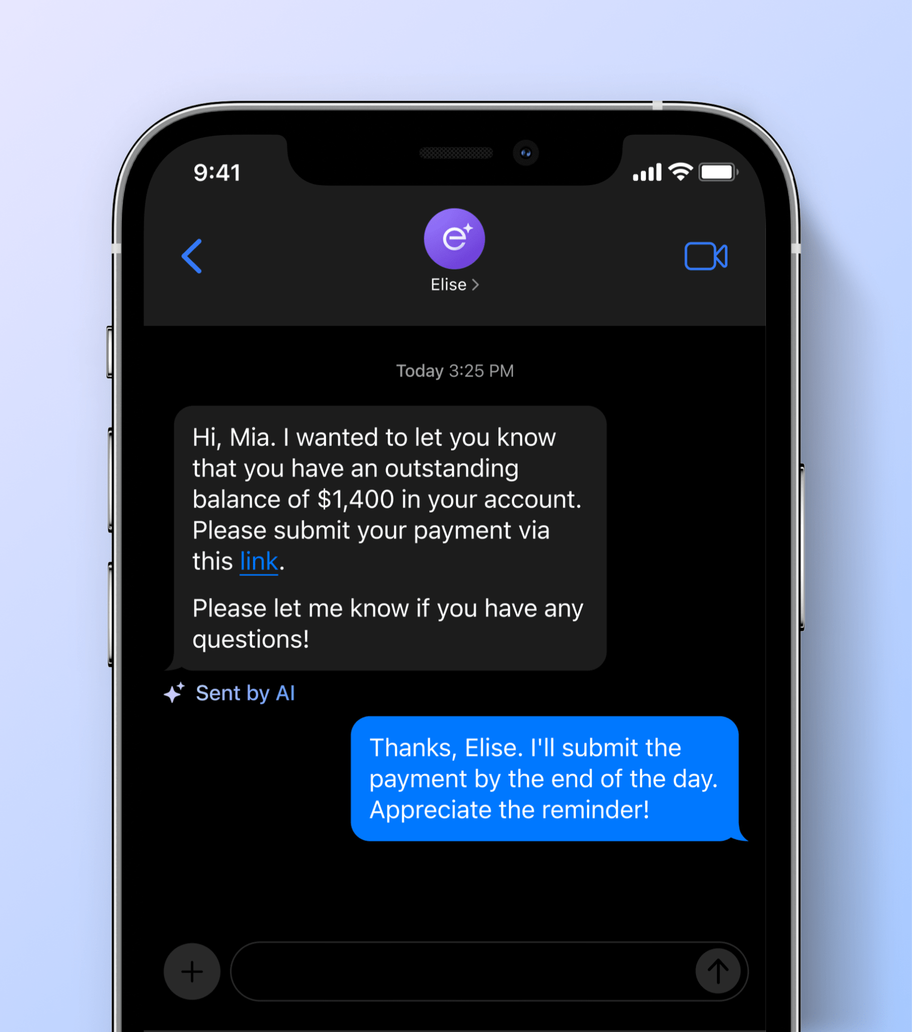
RESIDENTAI
AI to Support Collections
AI reduces the burden on AR teams by constantly monitoring resident ledgers, sending payment reminders, and following-up with delinquent residents.
Custom scheduling for rent reminders and notices with conversational AI to respond to resident questions regarding their charges. Shares ledger details via email and text message in order to proactively answer resident questions about charges. Makes outbound collections calls to delinquent residents and schedules follow-ups for when a residents makes a promise to pay. Pauses communications to resolve disputes or when starting the eviction process.

Slide 21
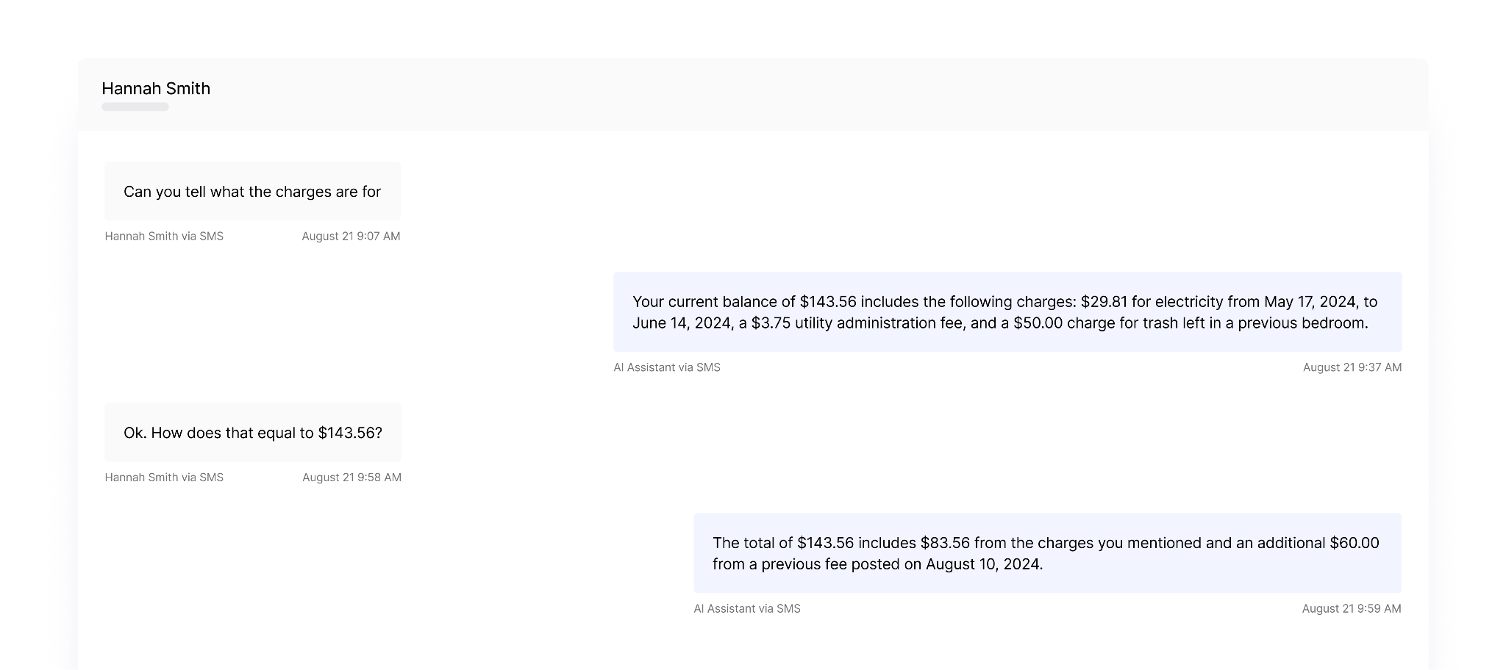
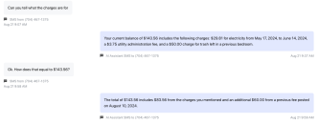
RESIDENTAI
Real Collections Conversation with a Resident
In addition to providing rent reminders and delinquency notices, the AI can convey charge details to residents to help them understand the makeup of their current balance as well as payment options.

Slide 22
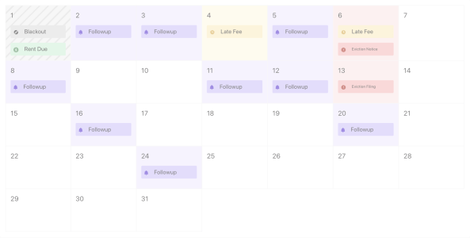
RESIDENTAI
Customizable Follow-Up Schedule
Outbound communication efforts can be customized to match existing processes or to ensure compliance with state-specific late fee dates. Outbound calls can be added to the schedule to further enhance follow-up efforts to delinquent residents.

Slide 23
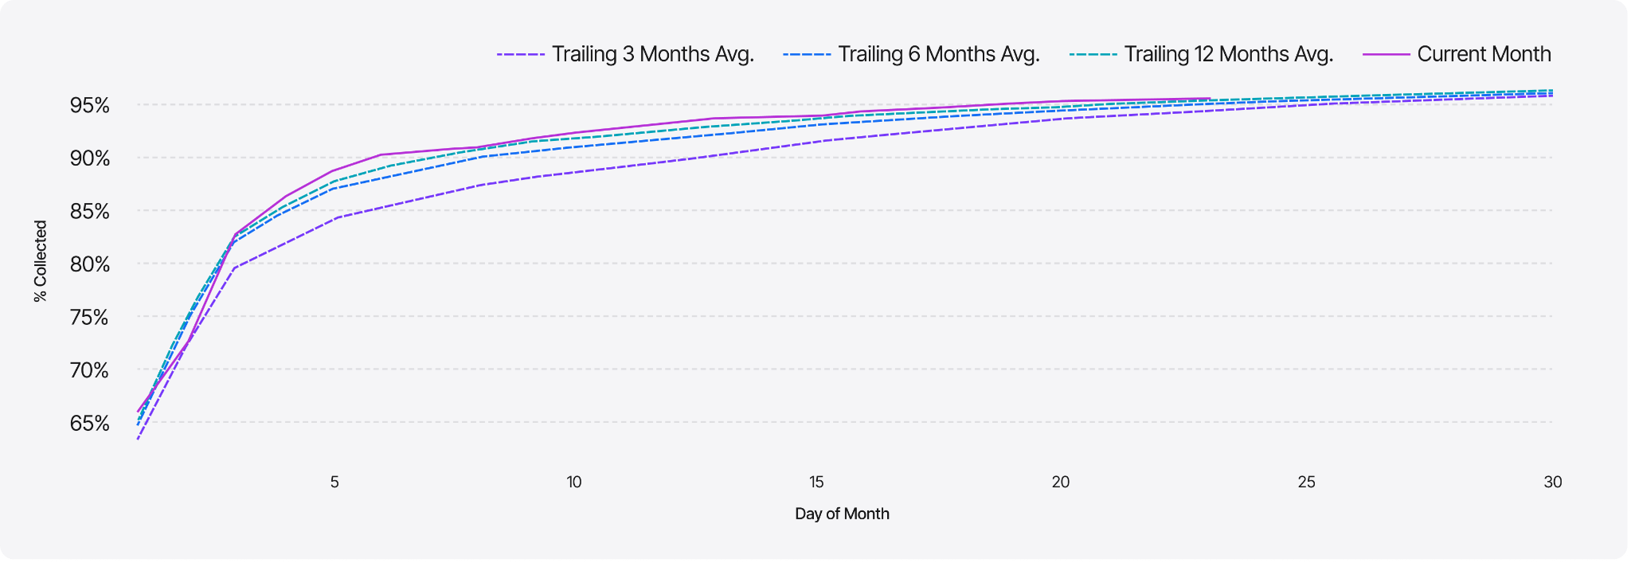
RESIDENTAI
Reporting Tools to Quantify Results
Keep track of collections performance over time relative to past periods (T3, T6, or T12) and monitor changes in collections rates and payment velocity. Easily measure the impact of AI-supported collections efforts.

Slide 24
What This Means for You
Role
Impact From AI Support
AR Agent
Fewer calls; less manual data entry; more complete record keeping
AR Manager
Fewer escalations; standardized collections reporting
Community Manager
Less reliance on third-party collections agencies; less employee burnout
Eviction Attorney
More complete picture of non-payment case and resident conversations
Resident
24/7 responsiveness for ledger-related questions

Slide 25
AI for Maintenance

Slide 26
AI SUPPORTED MAINTENANCE
Overcoming Maintenance Challenges
Challenge
How AI Can Assist
Costly escalations and overtime burden
Incomplete information about work orders
Scheduling headaches and PTE issues
Uncaptured resident sentiment
AI follows de-escalation flows before routing tickets intelligently
AI asks the right questions and collects relevant information and photos
AI serves as your scheduling assistant – no more back-and-forths
AI prompts reviews after detecting positive feedback
AI-supported maintenance unlocks quicker ticket resolution, fewer costly escalations, simplified scheduling, and ultimately, happier residents. It also reduces after-hours property visits and the associated overtime burden.

Slide 27
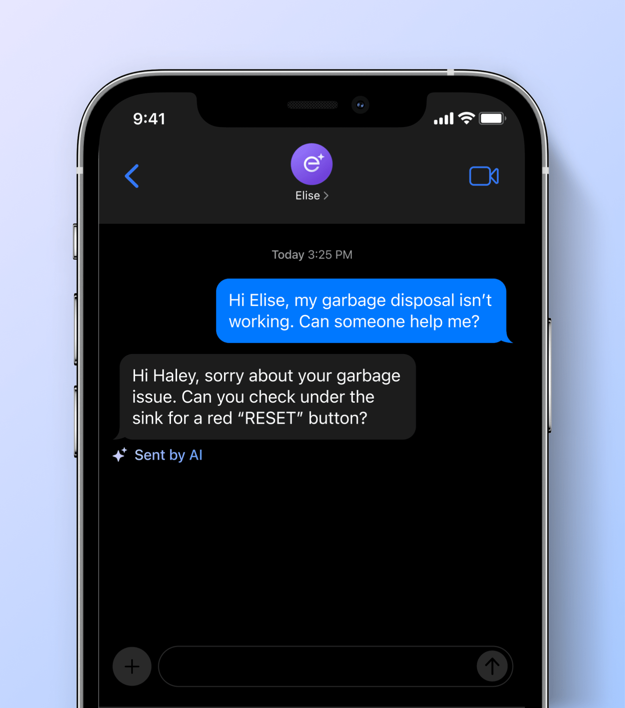
RESIDENTAI
Maintenance
AI tool that submits work orders, triages emergencies, helps residents self-service their unit, and follows up when a work order is completed.
Prospects can simply text, email, or call to easily file a work order. Asks for more details over the phone/SMS for comprehensive work order tickets. Prompts resident with DIY steps if the maintenance request can be troubleshooted in real-time. Routes calls to the right team based on pre-selected emergency contacts and de-escalates “non-emergency” requests.

Slide 28
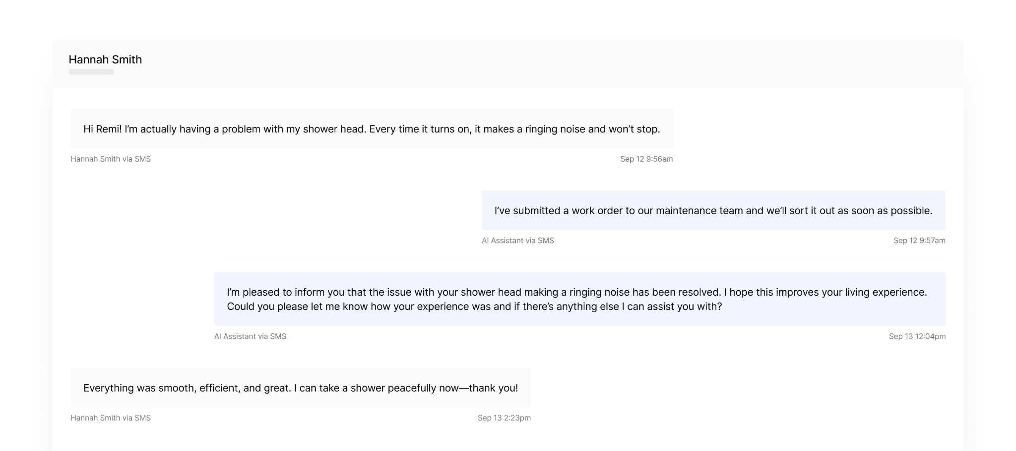
RESIDENTAI
Real Maintenance Conversation with a Resident
AI responds within 1 minute to the resident via their preferred method of communication and submits the work order on their behalf, with a follow-up afterword to confirm if the issue was addressed to the resident’s satisfaction.

Slide 29
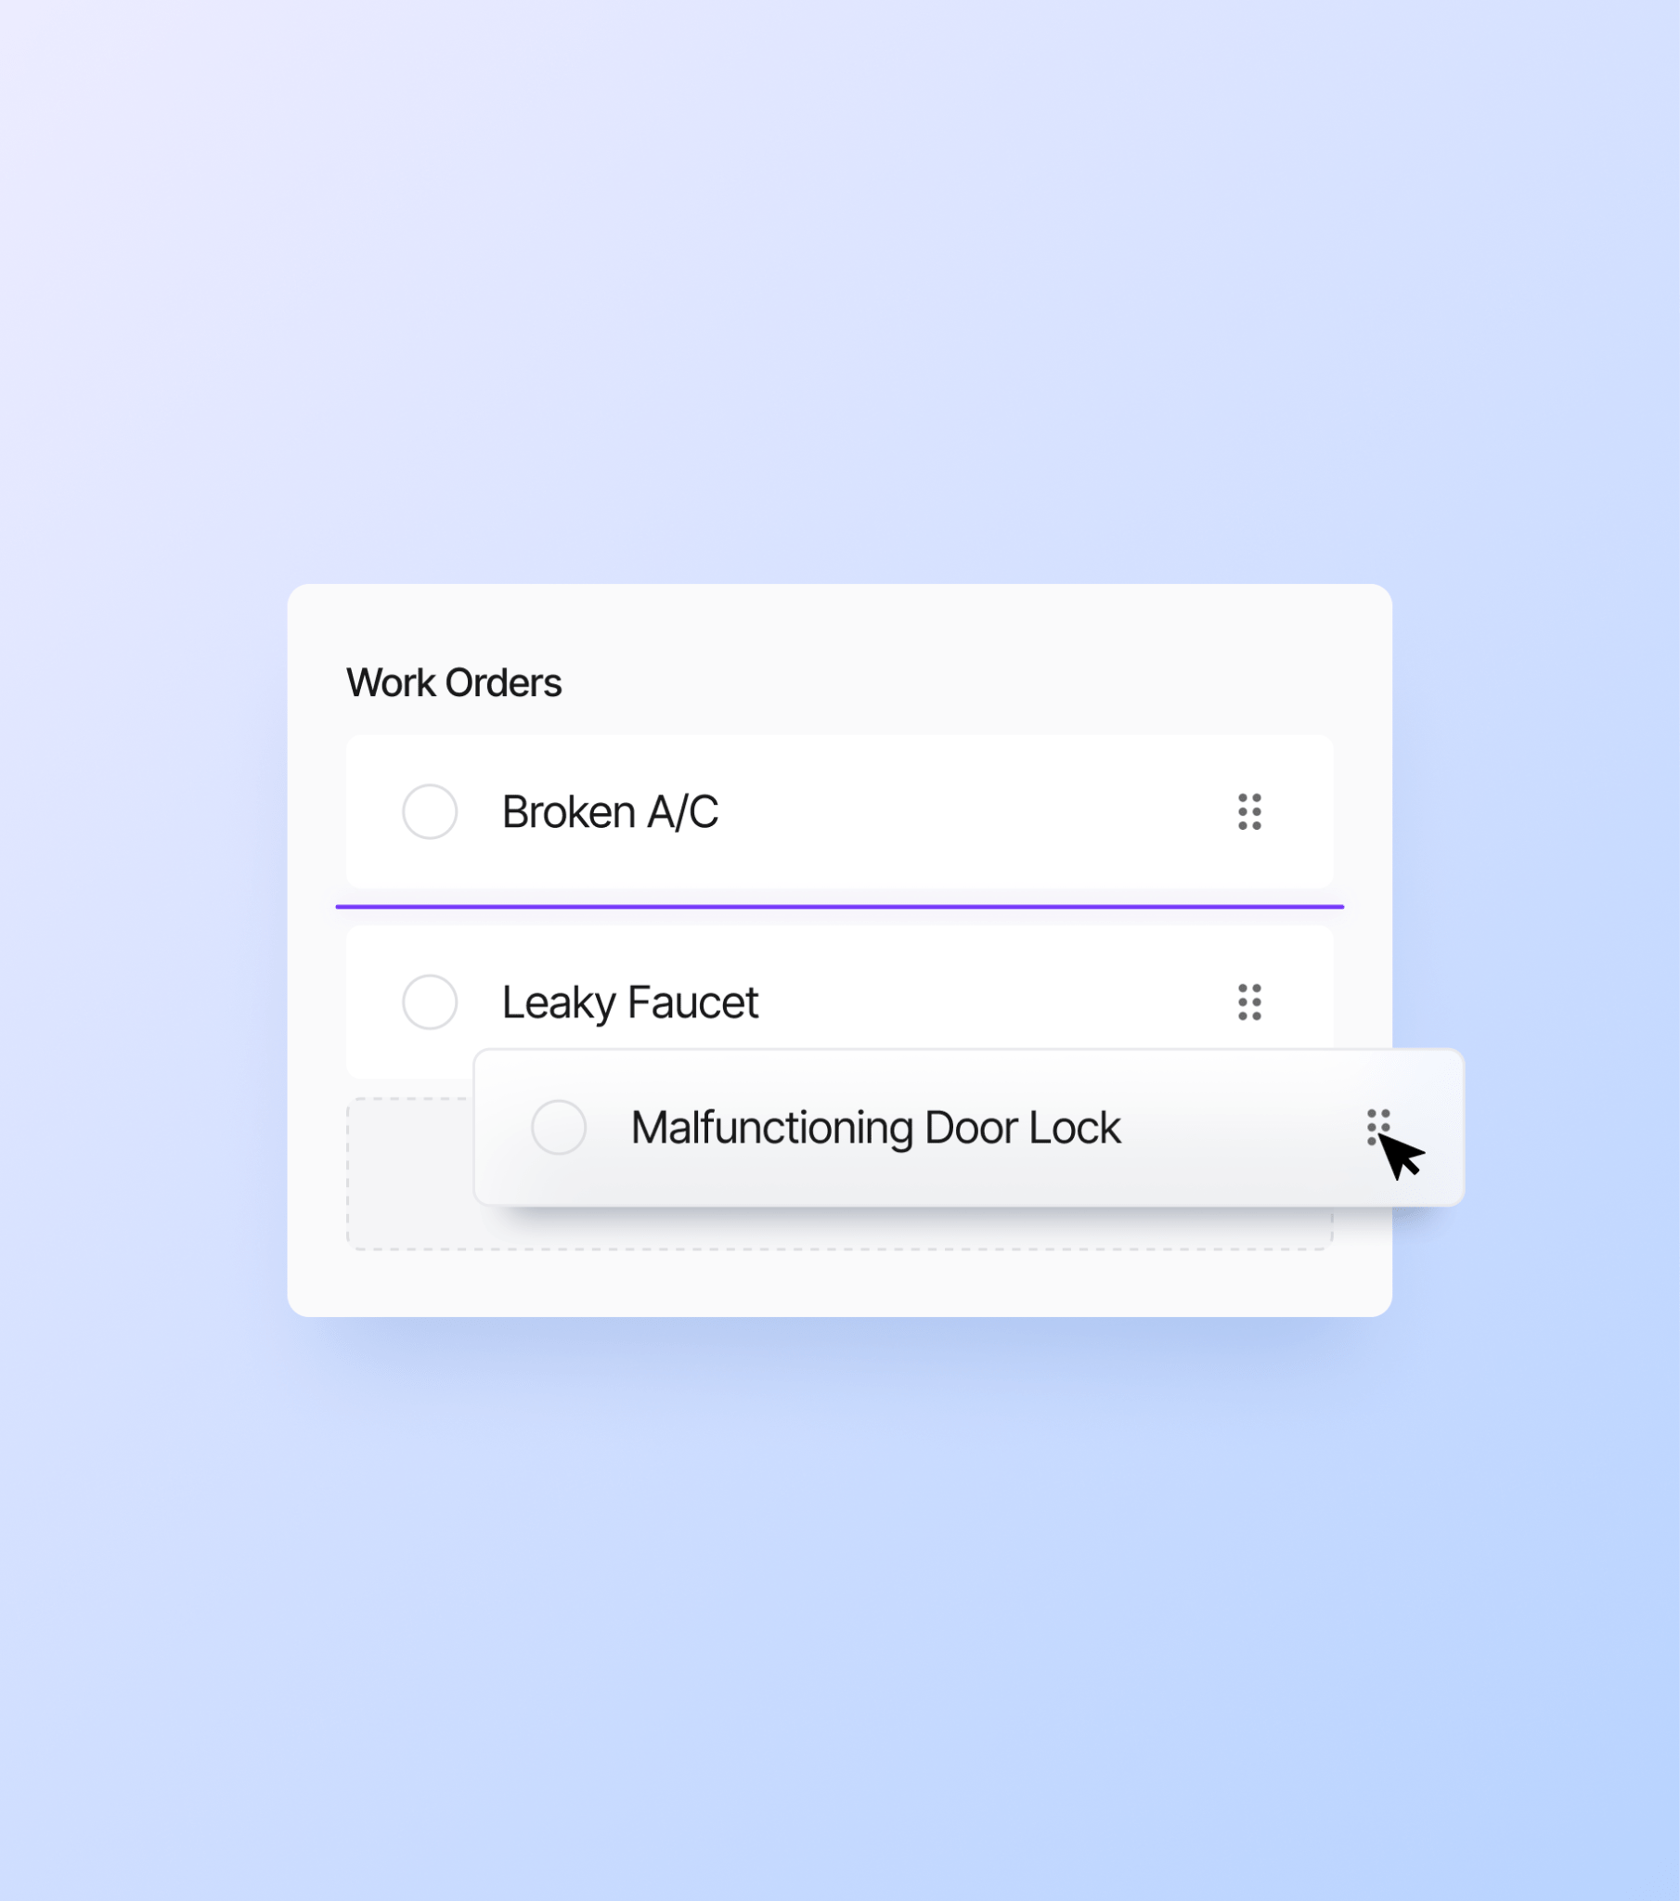
RESIDENTAI
Work Order Categories
Customize how work orders should be categorized and what constitutes an emergency maintenance issue.
De-escalates resident-defined emergencies to limit the need for after hours maintenance services Set categorizations for the entire organization, community groups, or individual communities. AI will follow these categorizations when submitting a work order into the PMS.

Slide 30
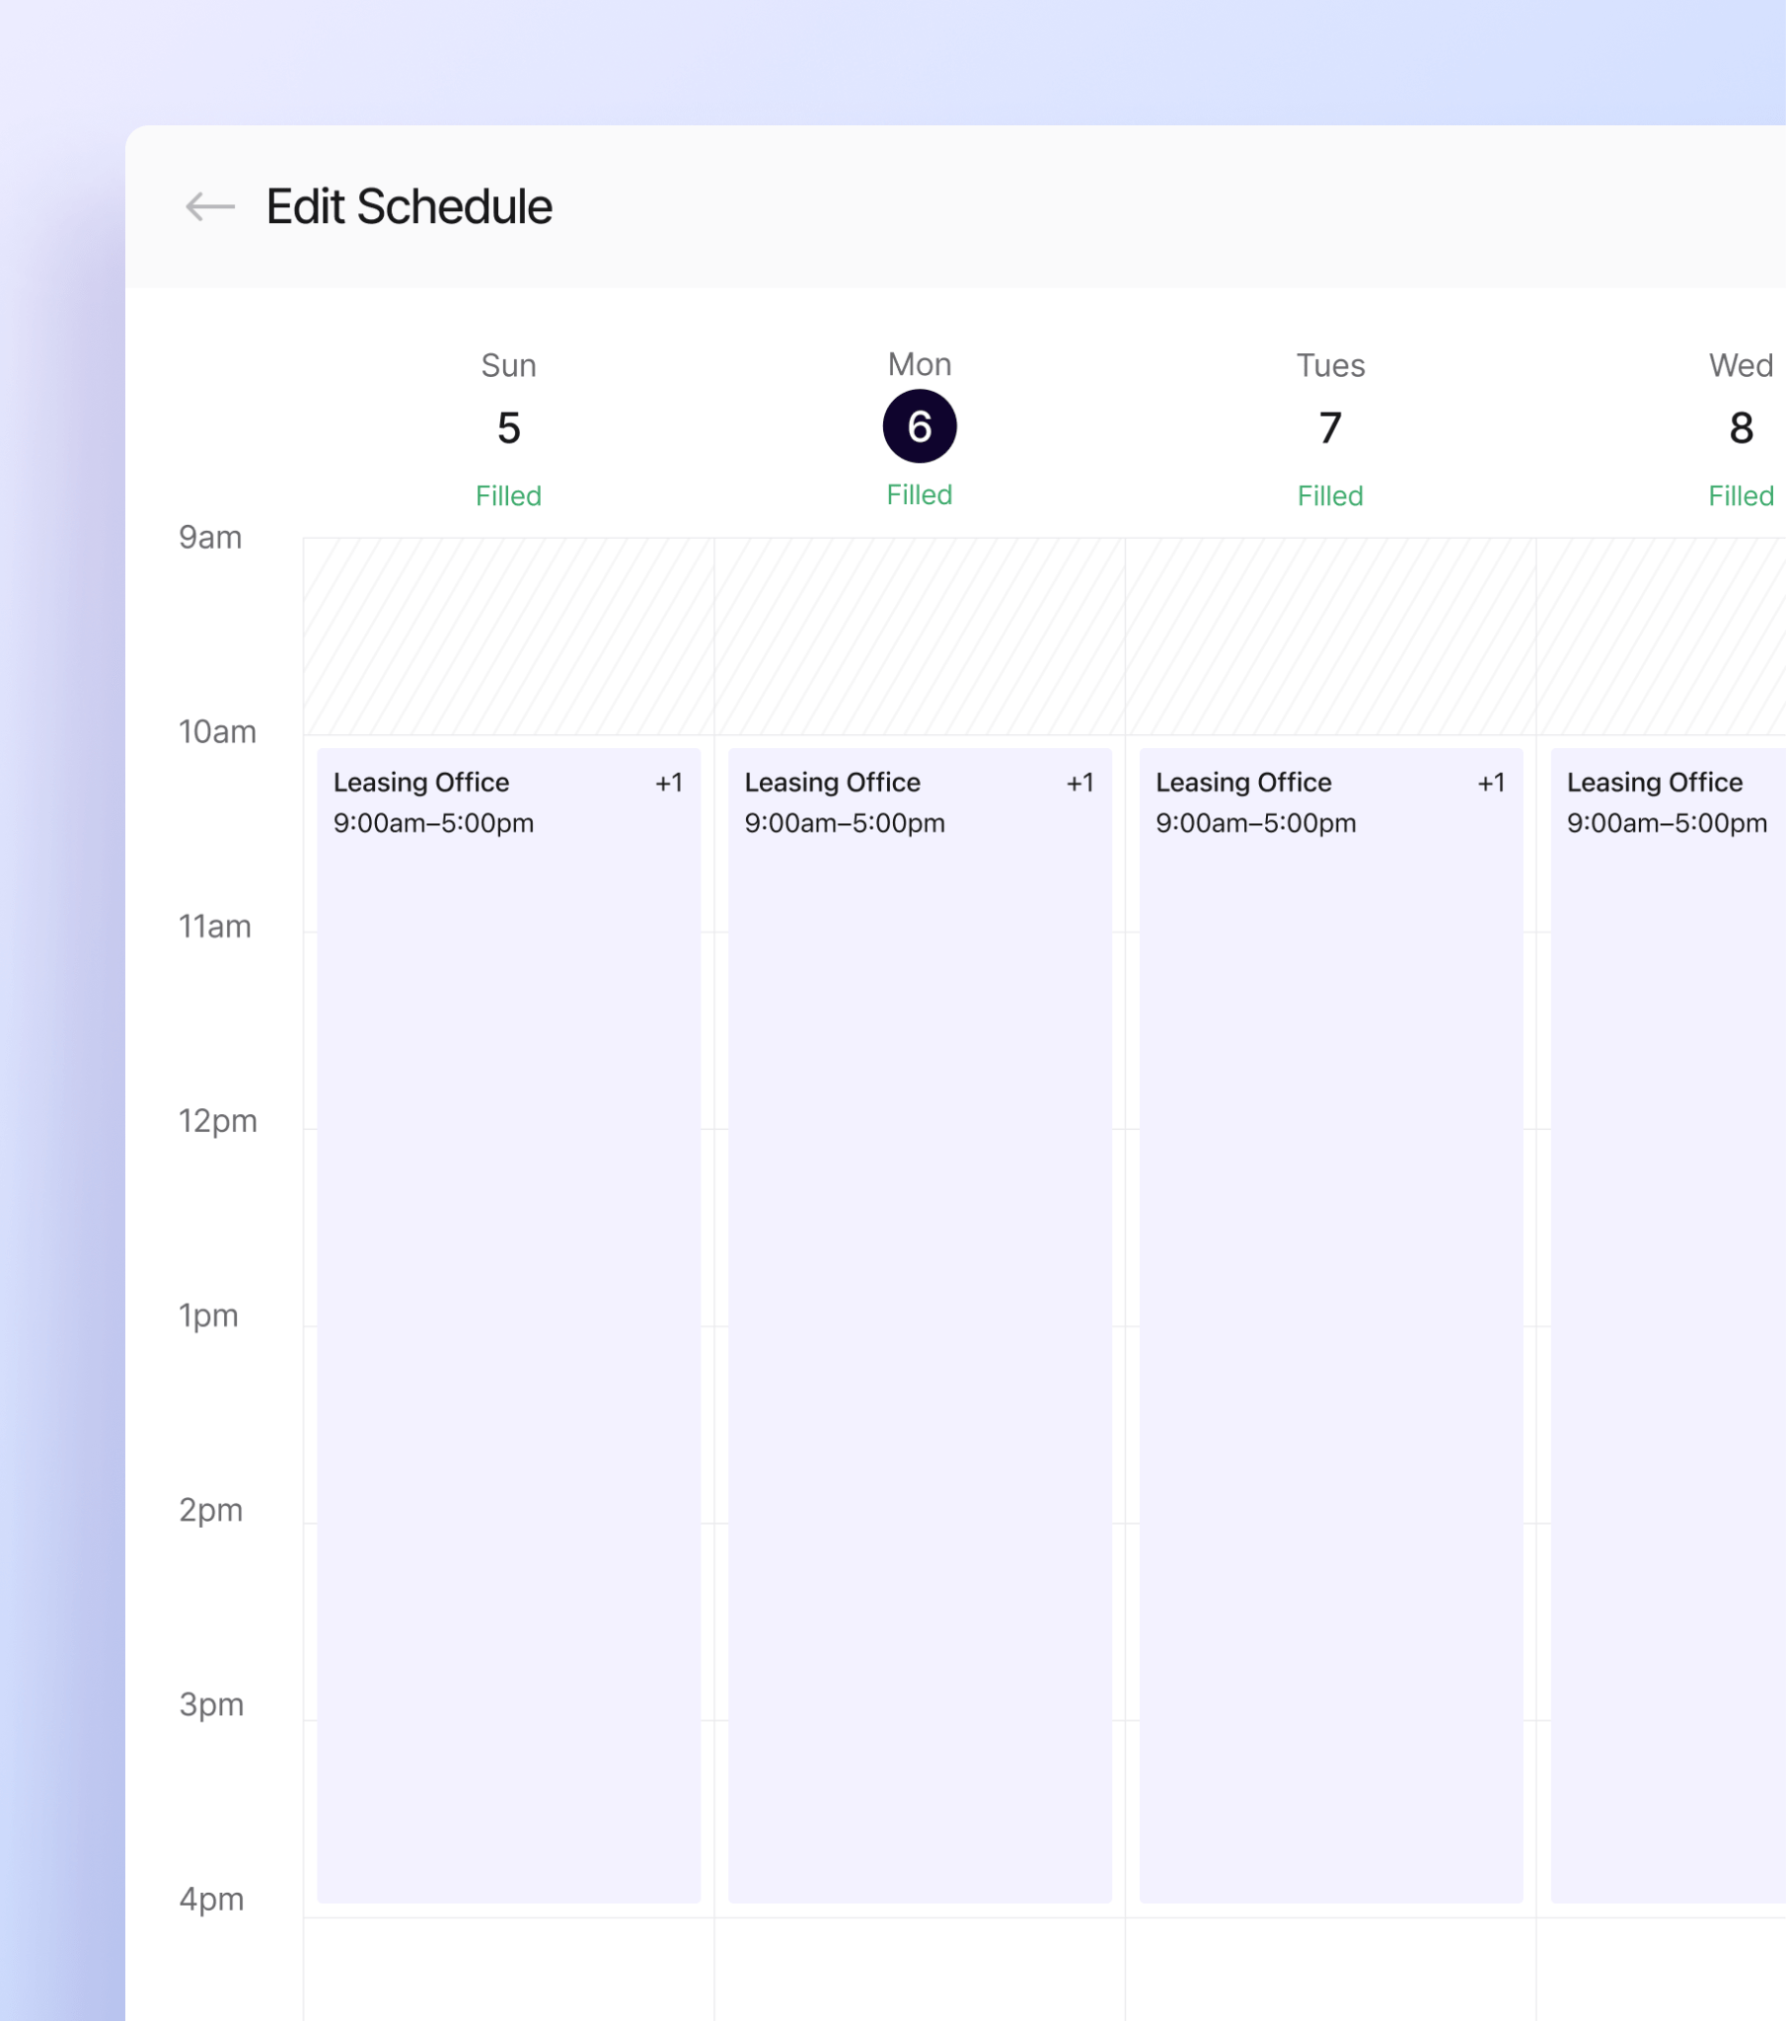
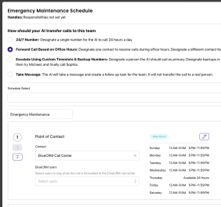
RESIDENTAI
After-Hours Support
EliseCRM allows teams to customize their call routing for after hours emergencies, based on the nature of the issue.
Setup emergency maintenance teams in EliseCRM for the call routing by the AI agent. Residents only have to communicate their issue - “lockout” - and the AI will use the routing setup in CRM to call the individuals who can help. Call routing can be customized by day and hour, to mirror the on-call schedule of the maintenance team. Replaces after-hours maintenance call services to reduce costs through an all-in-one solution.

Slide 31
What This Means for You
Role
Impact From AI Support
Maintenance Tech
Fewer late-night property visits; fewer scheduling headaches
Maintenance Supervisor
Less micromanagement of resident interactions; improved visibility
Community Manager
Reduced overtime burden; happier technicians; easier vendor coordination; improved renewal rates
Regional Manager
Reduced overtime burden; improved employee morale and resident retention
Resident
Clear lines of communication; quicker ticket resolution; easier self-service

Slide 32
AI for Renewals

Slide 33
AI SUPPORTED RENEWALS
Overcoming Renewals Challenges
Challenge
How AI Can Assist
Adherence to renewal touchpoint schedule
Incomplete information about renewal
Unresponsive residents
Frequent renewals escalations
AI follows your preset renewal follow-up cadence
AI provides detailed transcripts and summarizes all renewal interactions
AI provides an omnichannel outreach solution
AI reduces the likelihood of missed deadlines and unwanted surprises
AI-supported renewals unlocks a smoother renewal process, more complete resident sentiment information, and more time to foster the relationships that make renewing an easy decision.

Slide 34
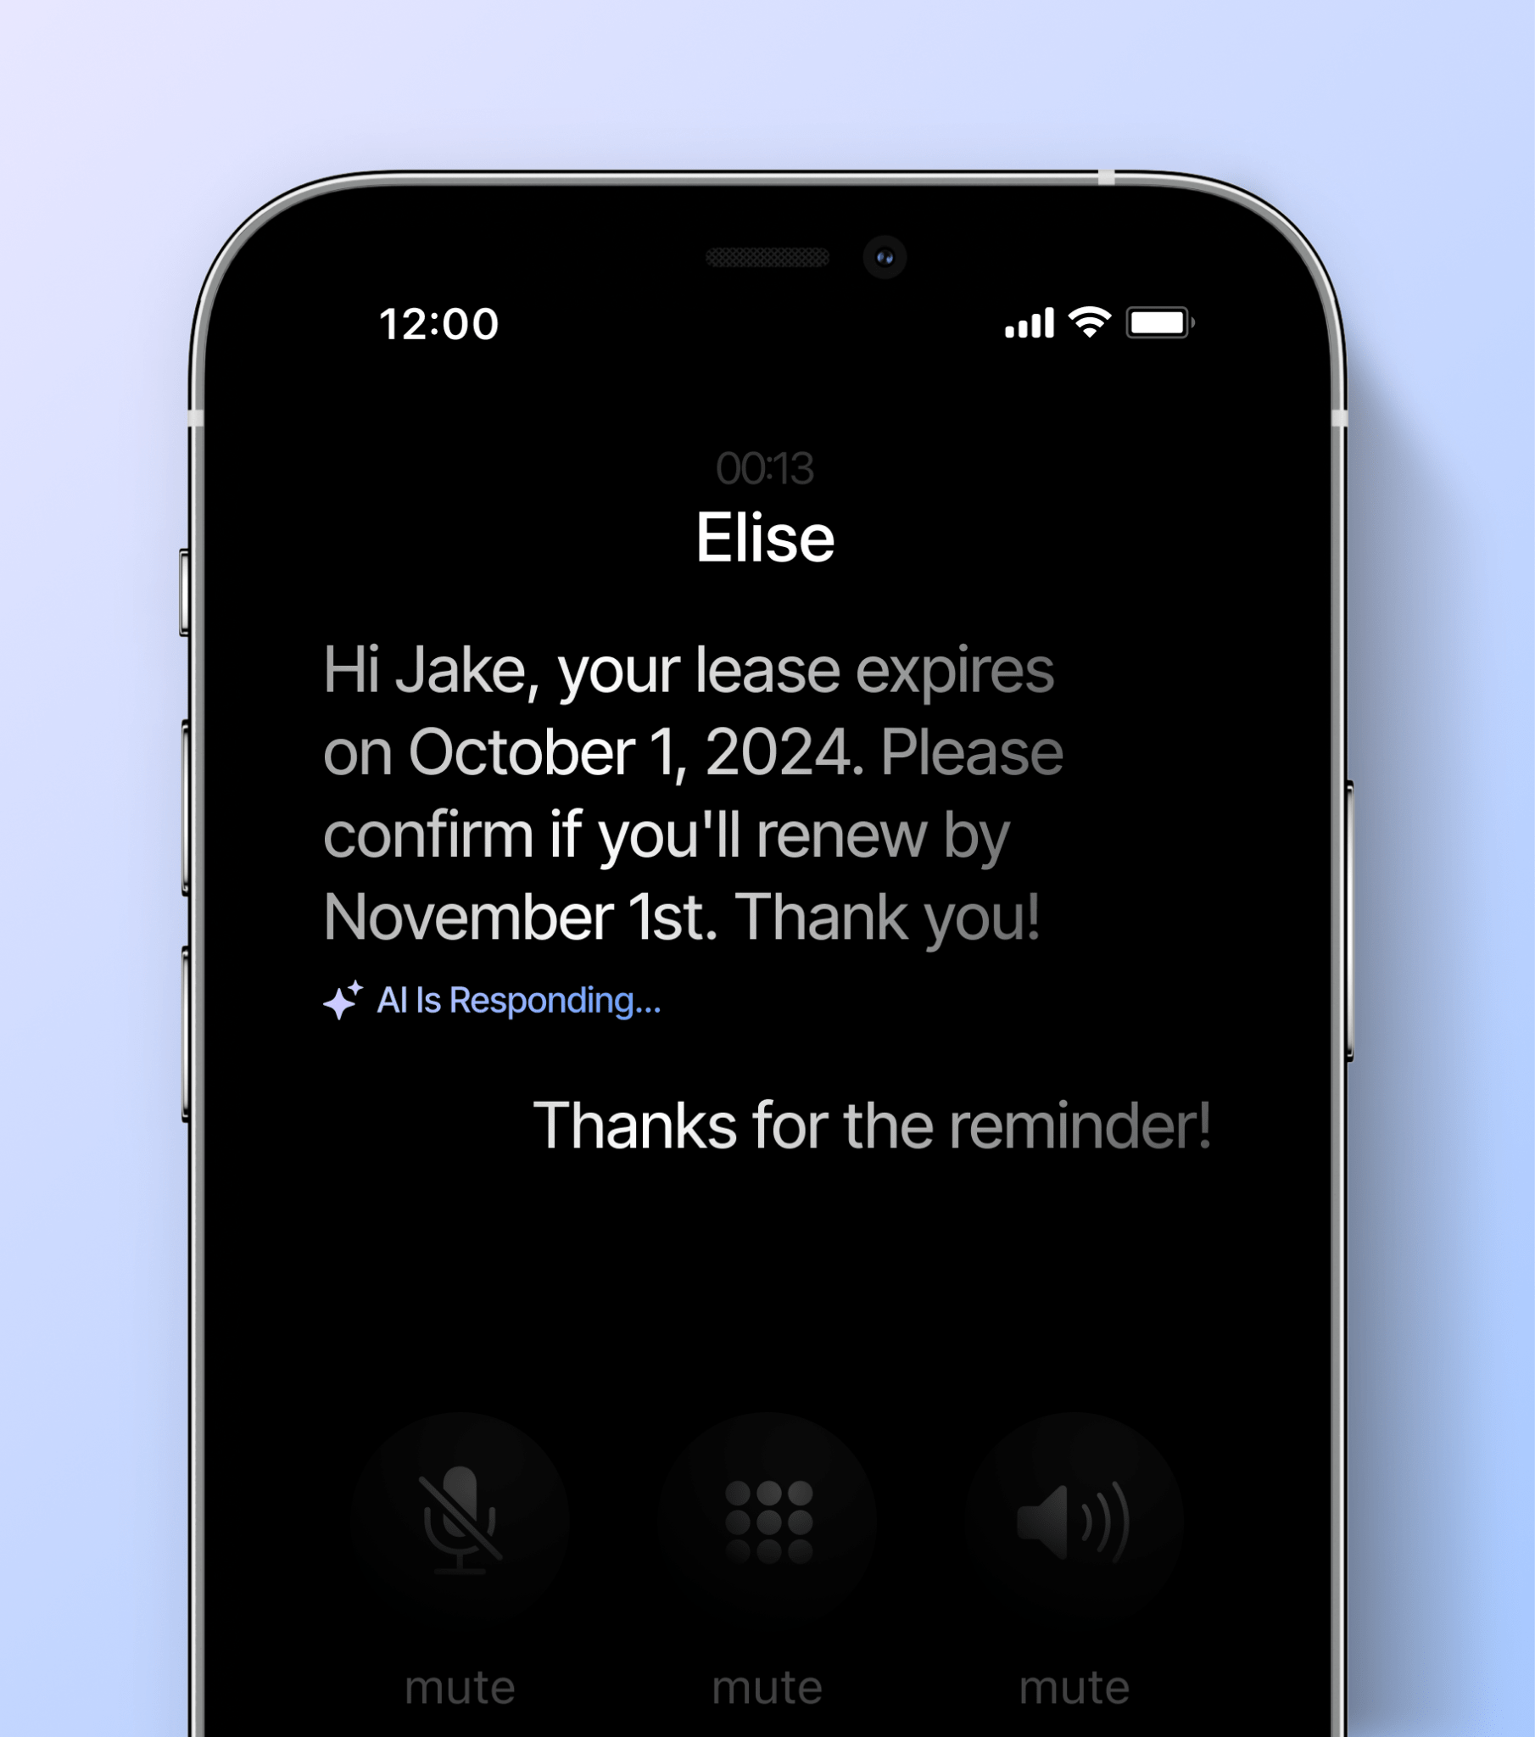
RENEWALS
AI-Powered Renewals
Automate your lease renewal notifications, send reminders, and proactively inform renters about rent changes and deadlines.
Customize your renewal touch-points while keeping detailed records of resident feedback and sentiment. 4-6 months ahead of renewal, your AI assistant will ask tenants whether they are looking to renew and gather reasons for not renewing. Proactively discuss renewals over the phone if the resident is calling in about anything else (additional authentication required).

Slide 35
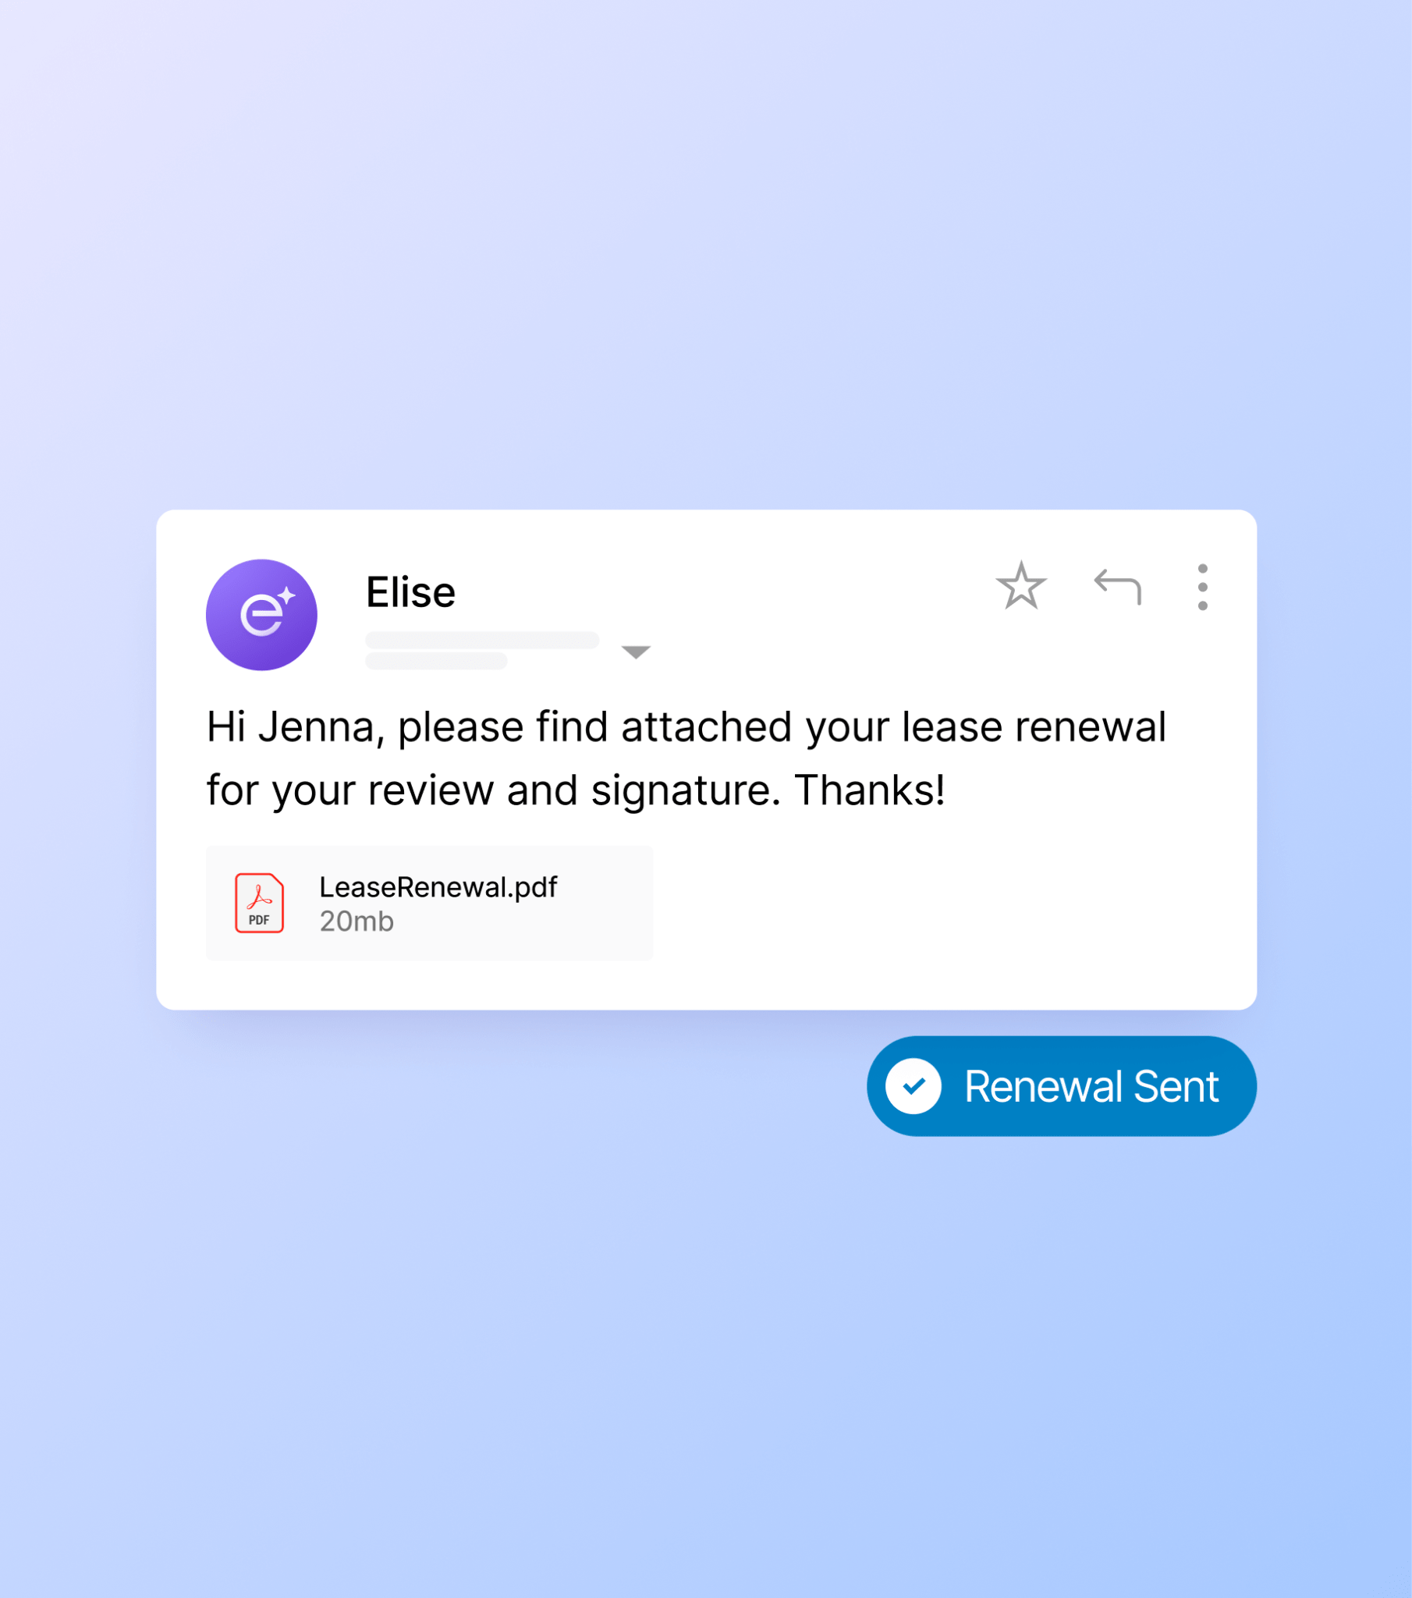
RENEWALS
EliseAI Handles the Renewal Process
Save effort managing residents up for renewal. Never fall behind on renewal outreach.
Lease notifications and reminders Renewal questions answered
Escalations on negotiations
Incentives, portfolio, and unit recommendations for those not renewing
Gathers resident feedback

Slide 36
RENEWALS
Predicting Likeliness to Renew
Your AI assistant documents all resident interactions and uses these records to inform renewal outreach efforts
Unit A7 • 1bd 1ba
Chloe Robinson
Unit B17 • 2bd 2ba
Paul Highland
Unit C20 • 2bd 1ba
Melissa Meadows
Lease End Date: Oct 1, 2024
Rent: $1,000
Resident History
Generally pays rent on time
Submitted 5 work orders, provided positive feedback
Likely to renew
Lease End Date: Nov 15, 2024
Rent: $3,000
Resident History
Late rent payment 2 times
Submitted 15 work orders
Submitted 3 noise complaints
Not likely to renew
possibly moving for new job
Lease End Date: Nov 20, 2024
Rent: $2,500
Resident History
Pays rent on time
Submitted 3 work orders
Asked about transferring to a
higher floor
Likely to renew

Slide 37
What This Means for You
Role
Impact From AI Support
Community Manager
Improved renewal rates; more accurate availability forecasts
Leasing Team
Less churn makes hitting leasing goals easier
Maintenance Team
Increased renewal rates mean bigger renewal incentives
Regional Manager
More predictable rental revenue
Resident
Fewer surprises when it comes time to renew

