Slide 1
AI Tools for
Onsite Operations

Slide 2
What Challenges Are
We Trying to Overcome?
Addressing onsite turnover, changing consumer preferences, and industry competition

Slide 3
INDUSTRY CHALLENGES
Why Are We Exploring AI & Automation?
Combat burnout & prioritize career development
Respond to changing consumer demands
Remain competitive in an evolving marketplace
Improve resident experience & property performance

Slide 4
INDUSTRY CHALLENGES
Why Explore AI & Automation?
Onsite Roles are Increasingly Demanding
A 2024 survey by the National Apartment Association found that, “...confrontational interactions and the struggle to separate work from personal time are major stressors for property management staff, potentially contributing to mental health concerns.”
Top 5 Challenges Working in Multifamily Property Management
NAA 2024 “The Voice of the Property Manager: Assessing the State of Property Management”
Dealing with abusive and aggressive residents and tenants
22.0%
Mental health and the inability to switch off after hours
16.3%
Maintaining property staffing levels
14.3%
Managing the workload
13.2%
Working with residents who are at risk of an eviction
6.9%

Slide 5
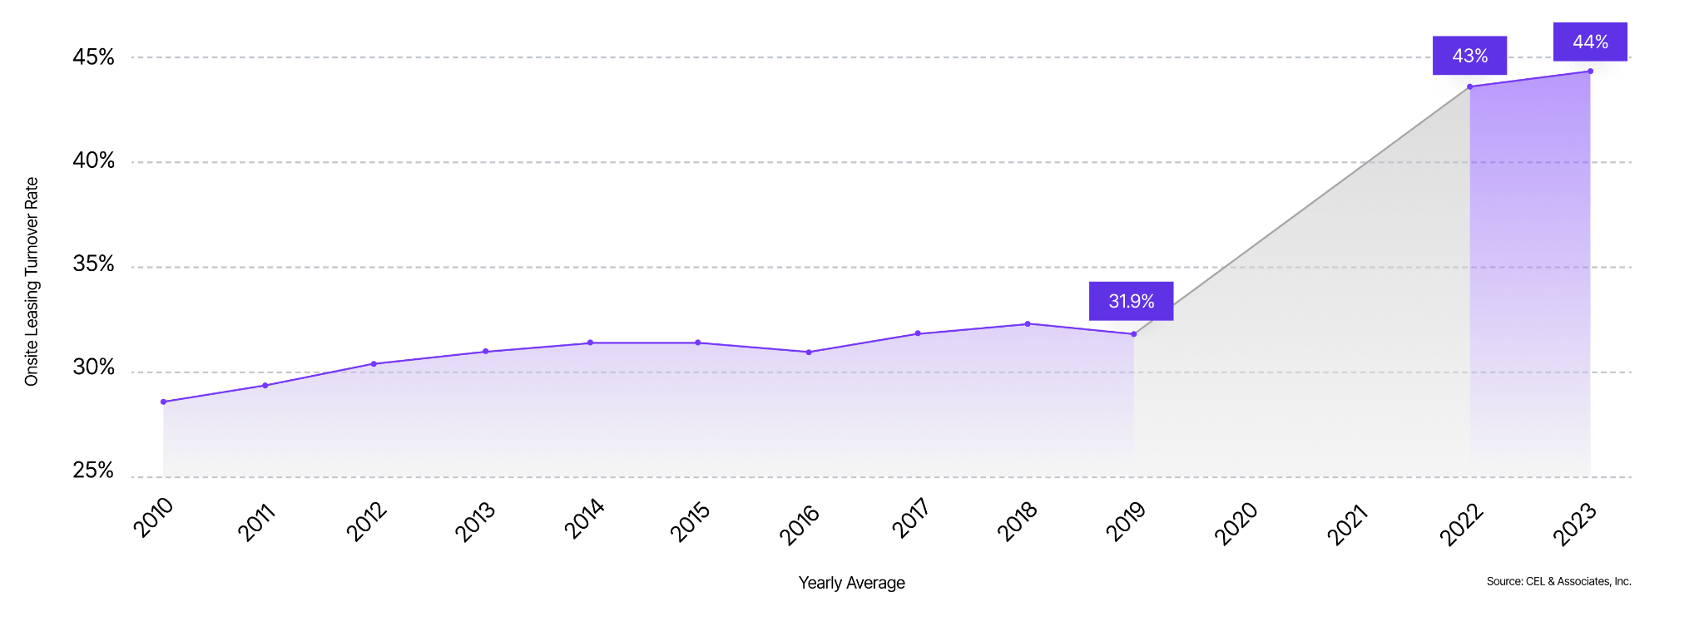
INDUSTRY CHALLENGES
Why Explore AI & Automation?
Heightened Turnover in Onsite Leasing Roles
The multifamily housing industry continues to see record high turnover in onsite leasing roles, resulting in inconsistent lead management and leasing efforts that impact asset performance.
^{A} Salmonsen, M. (2024) Aggressive tenants, mental health are top challenges for property managers, Multifamily Dive. Available at: https://www.multifamilydive.com/news/aggressive-tenants-mental-health-voice-of-the-property-manager/727809/?utm_source=Sailthru (Accessed: 24 Sep 2024).

Slide 6
INDUSTRY CHALLENGES
Why Explore AI & Automation?
“
Technology is not just a tool; it’s the foundation of modern customer experience.
Continued Changes in Consumer Behaviors and Expectations
The advent of on-demand services like Uber, Netflix, and Amazon Prime has changed consumer expectations around service and responsiveness. Renters expect 24/7 support, regardless of office hours or the availability of onsite teams.
Brian Chesky Co-Founder & CEO of Airbnb

Slide 7
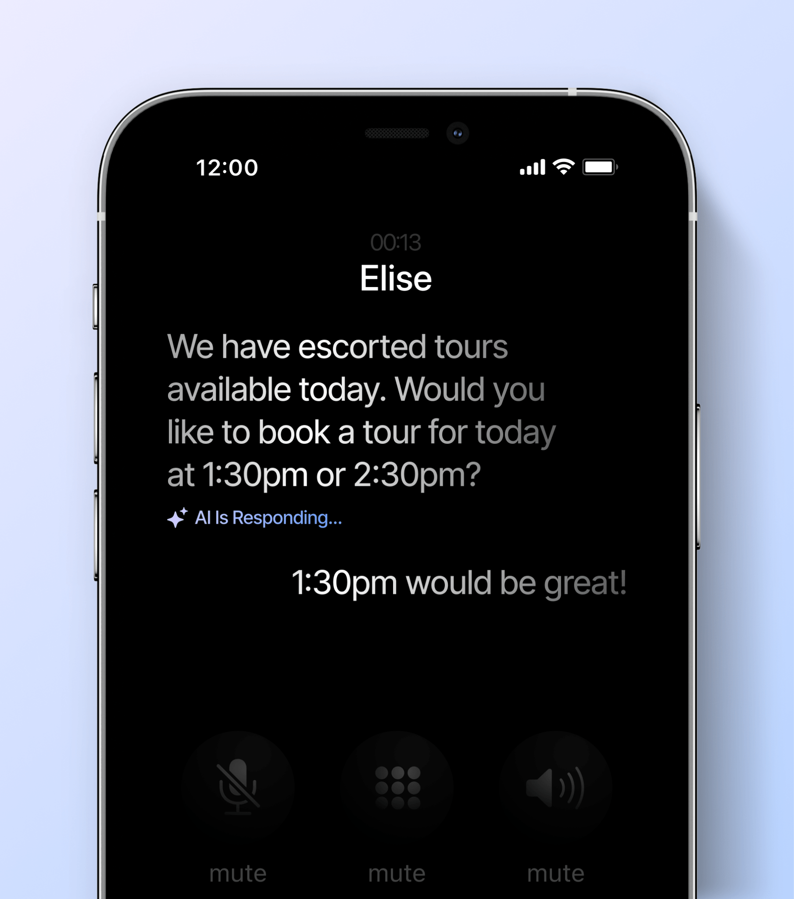
INDUSTRY CHALLENGES
Why Embrace AI?
Industry Adoption and Need to Compete
As consumer expectations evolve, leasing and resident services now require 24/7 coverage - leading to increased burnout and turnover among onsite teams.
By adopting conversational AI, communities can adapt to these changes seamlessly, gaining a competitive edge in managing leads and retaining residents, especially compared to competitors without AI support.
AI responds quickly to prospects and residents, improving lead conversion and resident retention.
If a prospect doesn’t hear back from a leasing agent, they move on to a more responsive competitor.

Slide 8
AI for Onsite Operations

Slide 9
The Role of AI
LEVERAGING TECHNOLOGY
Automating Prospect & Resident Conversations
Conversational AI allows for the automation of prospect & resident interactions related to leasing, maintenance, rent collection efforts, & lease renewal conversations.
Leveraging AI saves countless hours for onsite teams while ensuring proactive outreach and consistent, timely responses.
Leasing
Answer, qualify, and schedule tours for all leads.
Maintenance Requests
Track and ticket resident work orders.
Delinquency
Remind renters of & track all on-time and late payments.
Lease Renewals
Automate & inform residents of upcoming lease renewals.

Slide 10
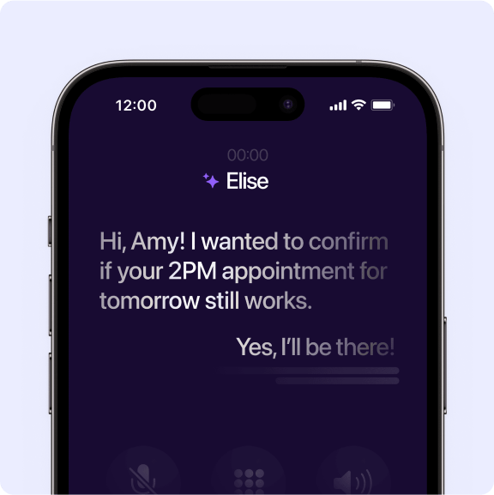
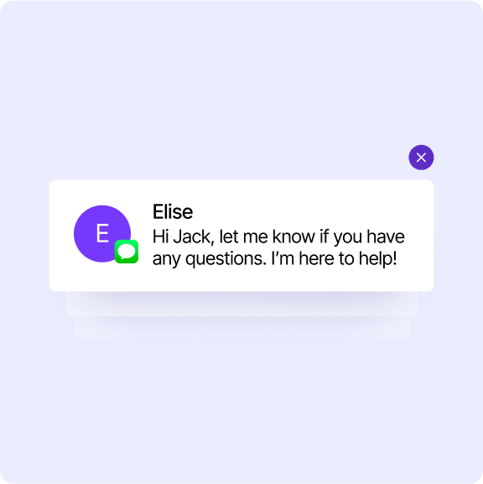
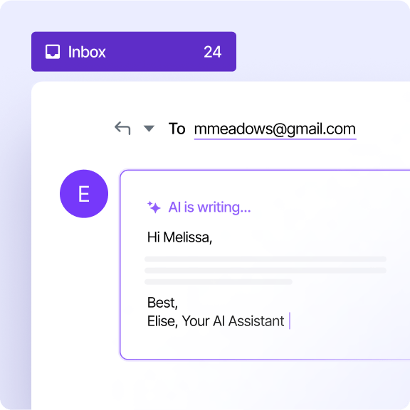
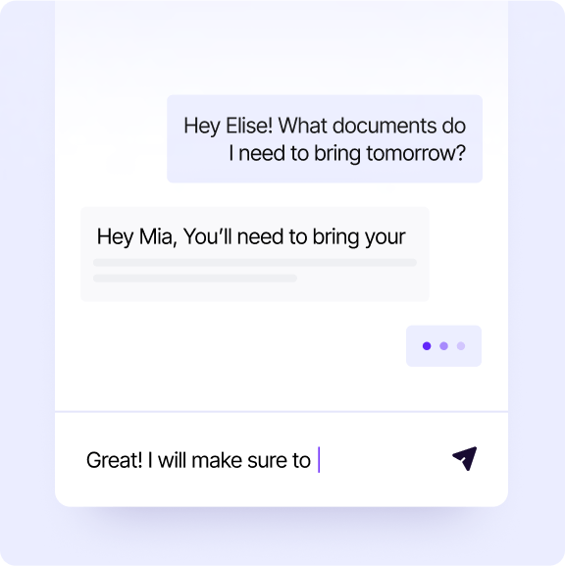
The Role of AI
LEVERAGING TECHNOLOGY
Omni Channel 24/7 Support
Conversational AI can be deployed across phone, text, email, & web-based chat to meet customer needs, provide 24hr service, & offer consistent communications across channels.
Voice
AI answers calls 24/7 with no hold time and can even make outbound calls.
Text
AI reaches out via SMS, making communications easy, even on-the-go.
Email
AI manages inboxes, responds to incoming messages and can handle following up.
Chat
AI responds to requests from prospects and residents right from your website.

Slide 11
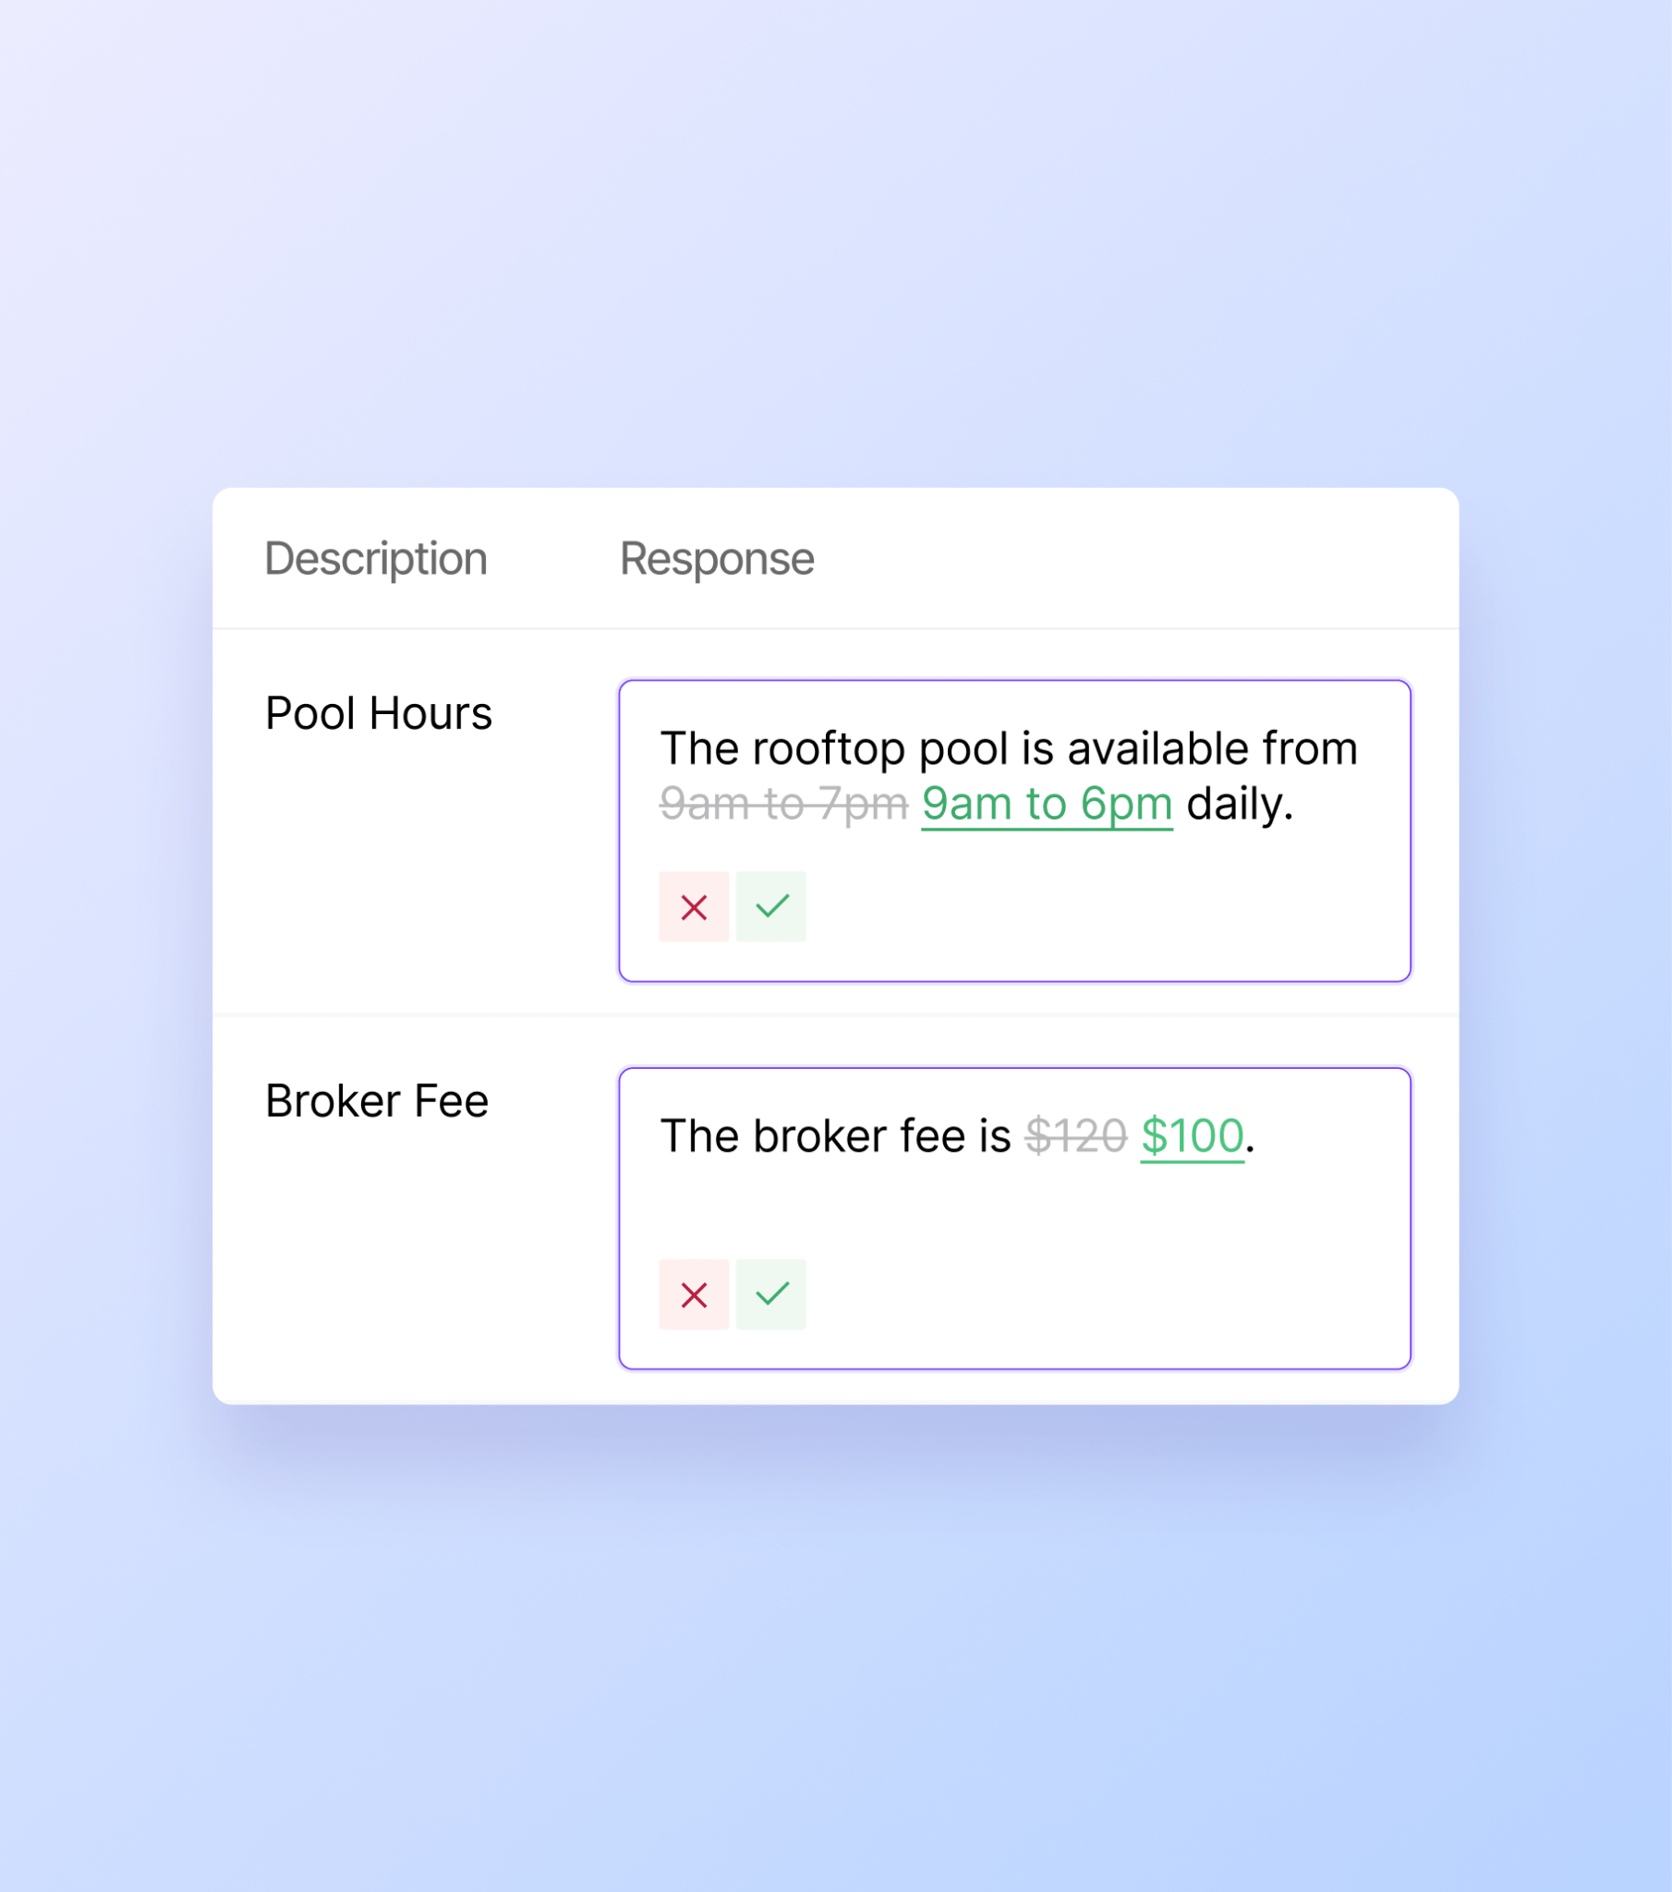
The Role of AI
LEVERAGING TECHNOLOGY
Supporting Onsite Teams
Conversational AI isn’t here to replace the human touch - it’s here to empower teams by handling routine tasks that hinder productivity.
EliseAI is the only platform with a fully visible Knowledge Bank, enabling teams to access and update property-specific information for responses that reflect human expertise.
With their new AI assistant, high-performing teams can focus more on meaningful, in-person interactions.

Slide 12
LEVERAGING TECHNOLOGY
Misconceptions About AI
There is a misconception that conversational AI tools are only suited for Class A communities or struggling assets.
Across the 3 million+ units utilizing EliseAI’s technology, ownership groups have found significant efficiency gains & cost-savings opportunities by deploying AI to offer 24/7 customer support, automate processes, and reduce the workload of their onsite teams regardless of the asset class, type, or current operating performance.
AI Only Supports Struggling Communities
Implementing AI Tools Will Create More Work
AI Makes Up Answers
The time savings & automation introduced by AI will provide a lift to all communities, even top-performers & distressed assets.
An up-front investment in AI is no different than onboarding a new team member, with time-savings gains once deployed.
You set the guardrails. Initially, AI may expose gaps in the information you feed it. Treat these gaps as opportunities for progress.

Slide 13
Why EliseAI?
The only end-to-end AI product suite that covers the entire renter journey

Slide 14
ELISEAI
Trusted AI Partner For
The AI Platform for Top Property Management Companies
Functionality to support:
Multifamily
Affordable
Single Family
Student Housing
Centralized
3 Million+
Units
415+
Companies

Slide 15
ELISEAI
Conversational AI for Property Operations
EliseAI offers conversational AI tools with machine-learning capabilities to automate conversations with prospects and residents at all stages of the customer journey.
AI Portal
Lead management efforts with prospects
Tour schedule and post-tour follow-ups
Application management and lease issuances
Rent collection and delinquency follow-ups
Work order submissions and categorization
Renewal offer issuances
Inbound phone call management and routing

Slide 16
ELISEAI
How Does The AI Work
1
2
3
Integrates with Our Systems API integration with our CRM and PMS to automatically push and pull data.
Engages via Multiple Channels The AI will engage in inbound and outbound communications with prospects and residents using voice, email, text, and web chat.
Self-Learning AI learns from agent responses, handling more complex tasks and boosting automation for better efficiency and personalized communication.

Slide 17
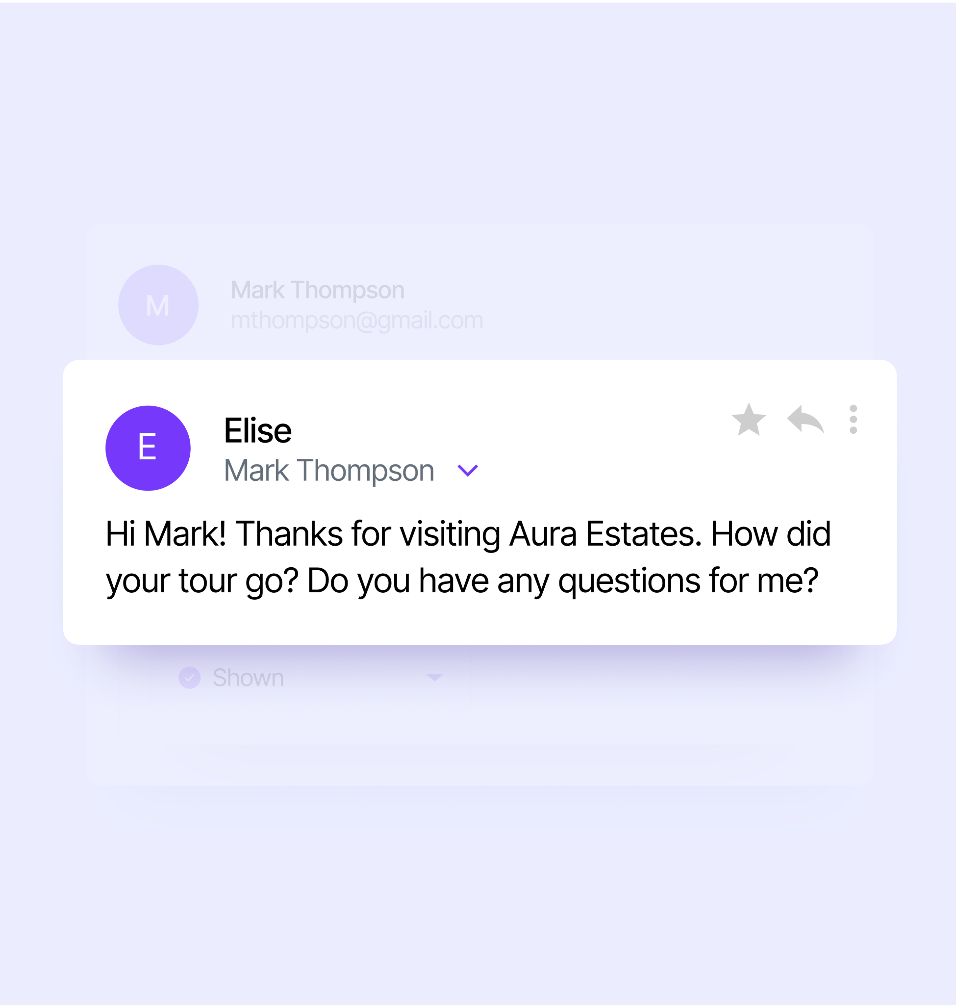
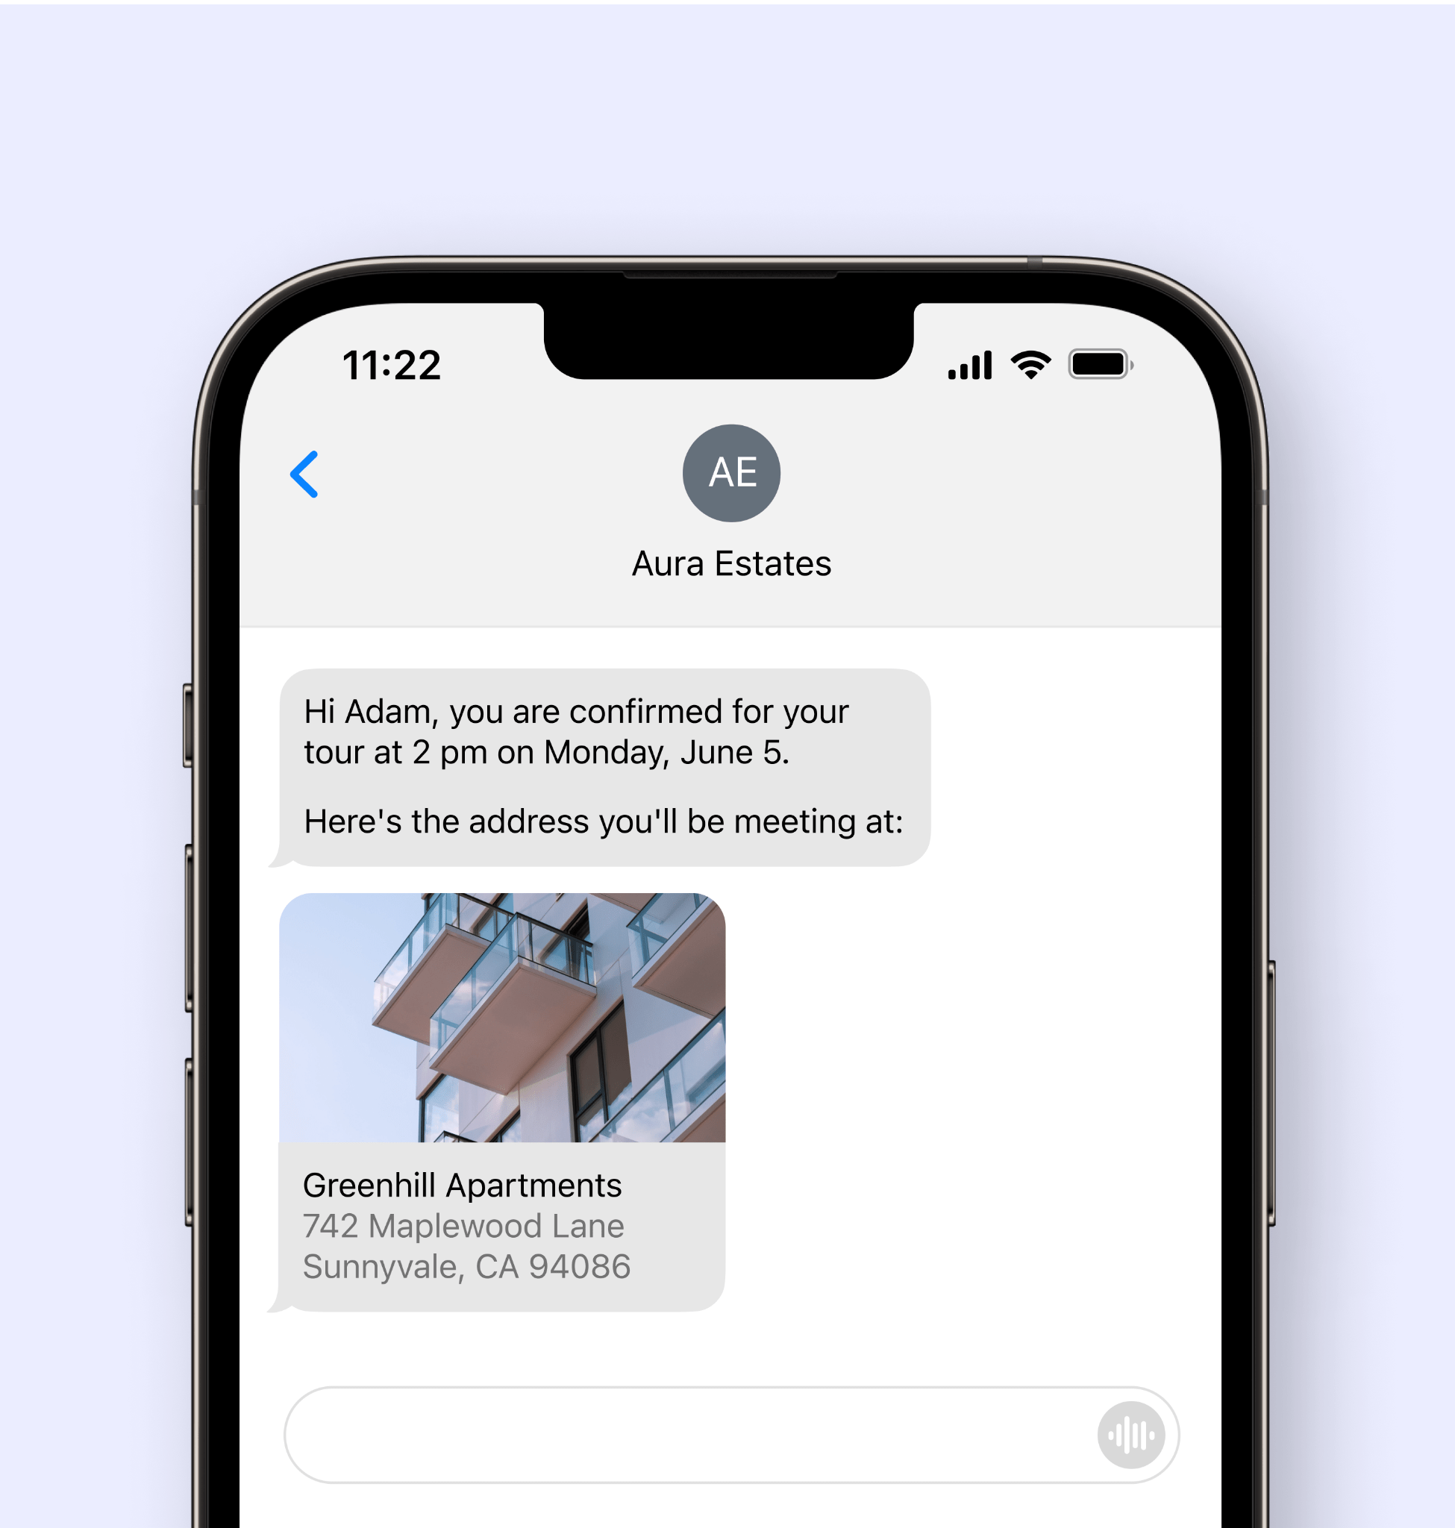
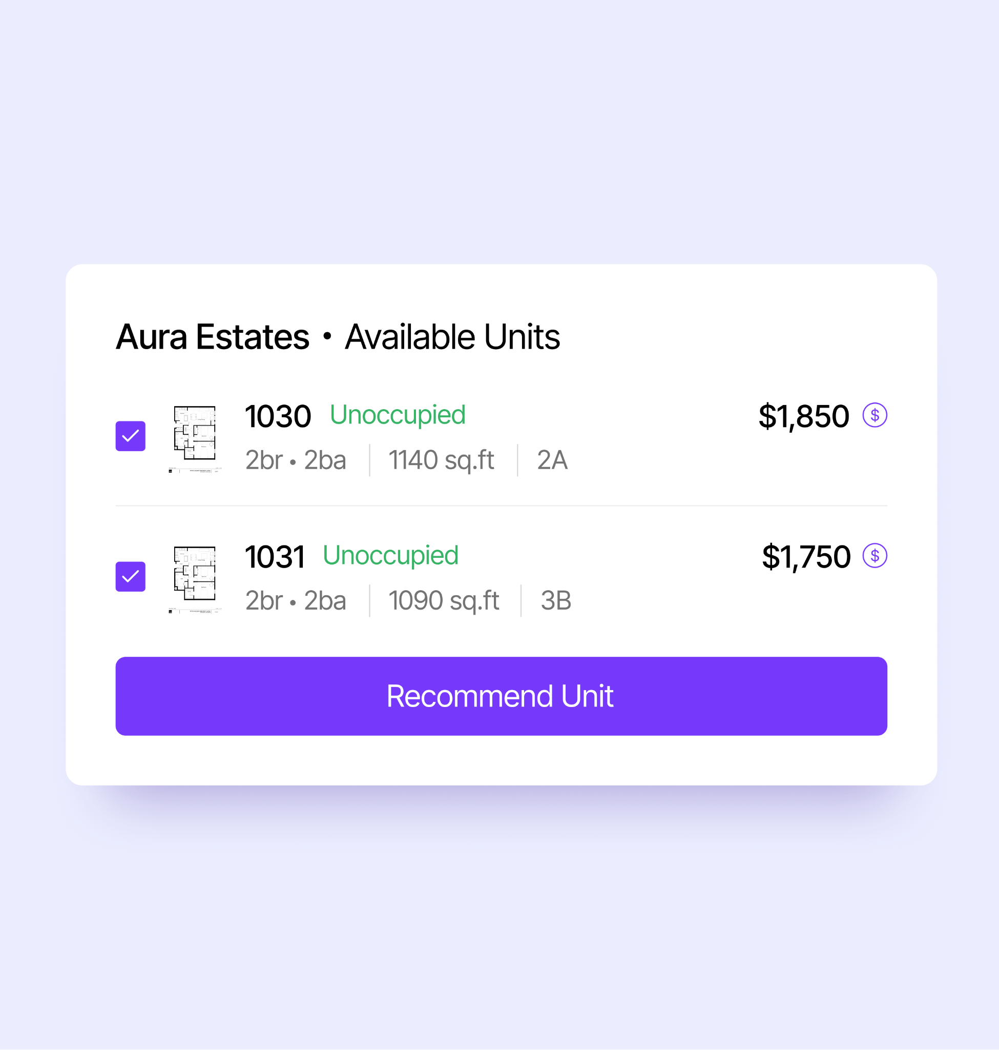
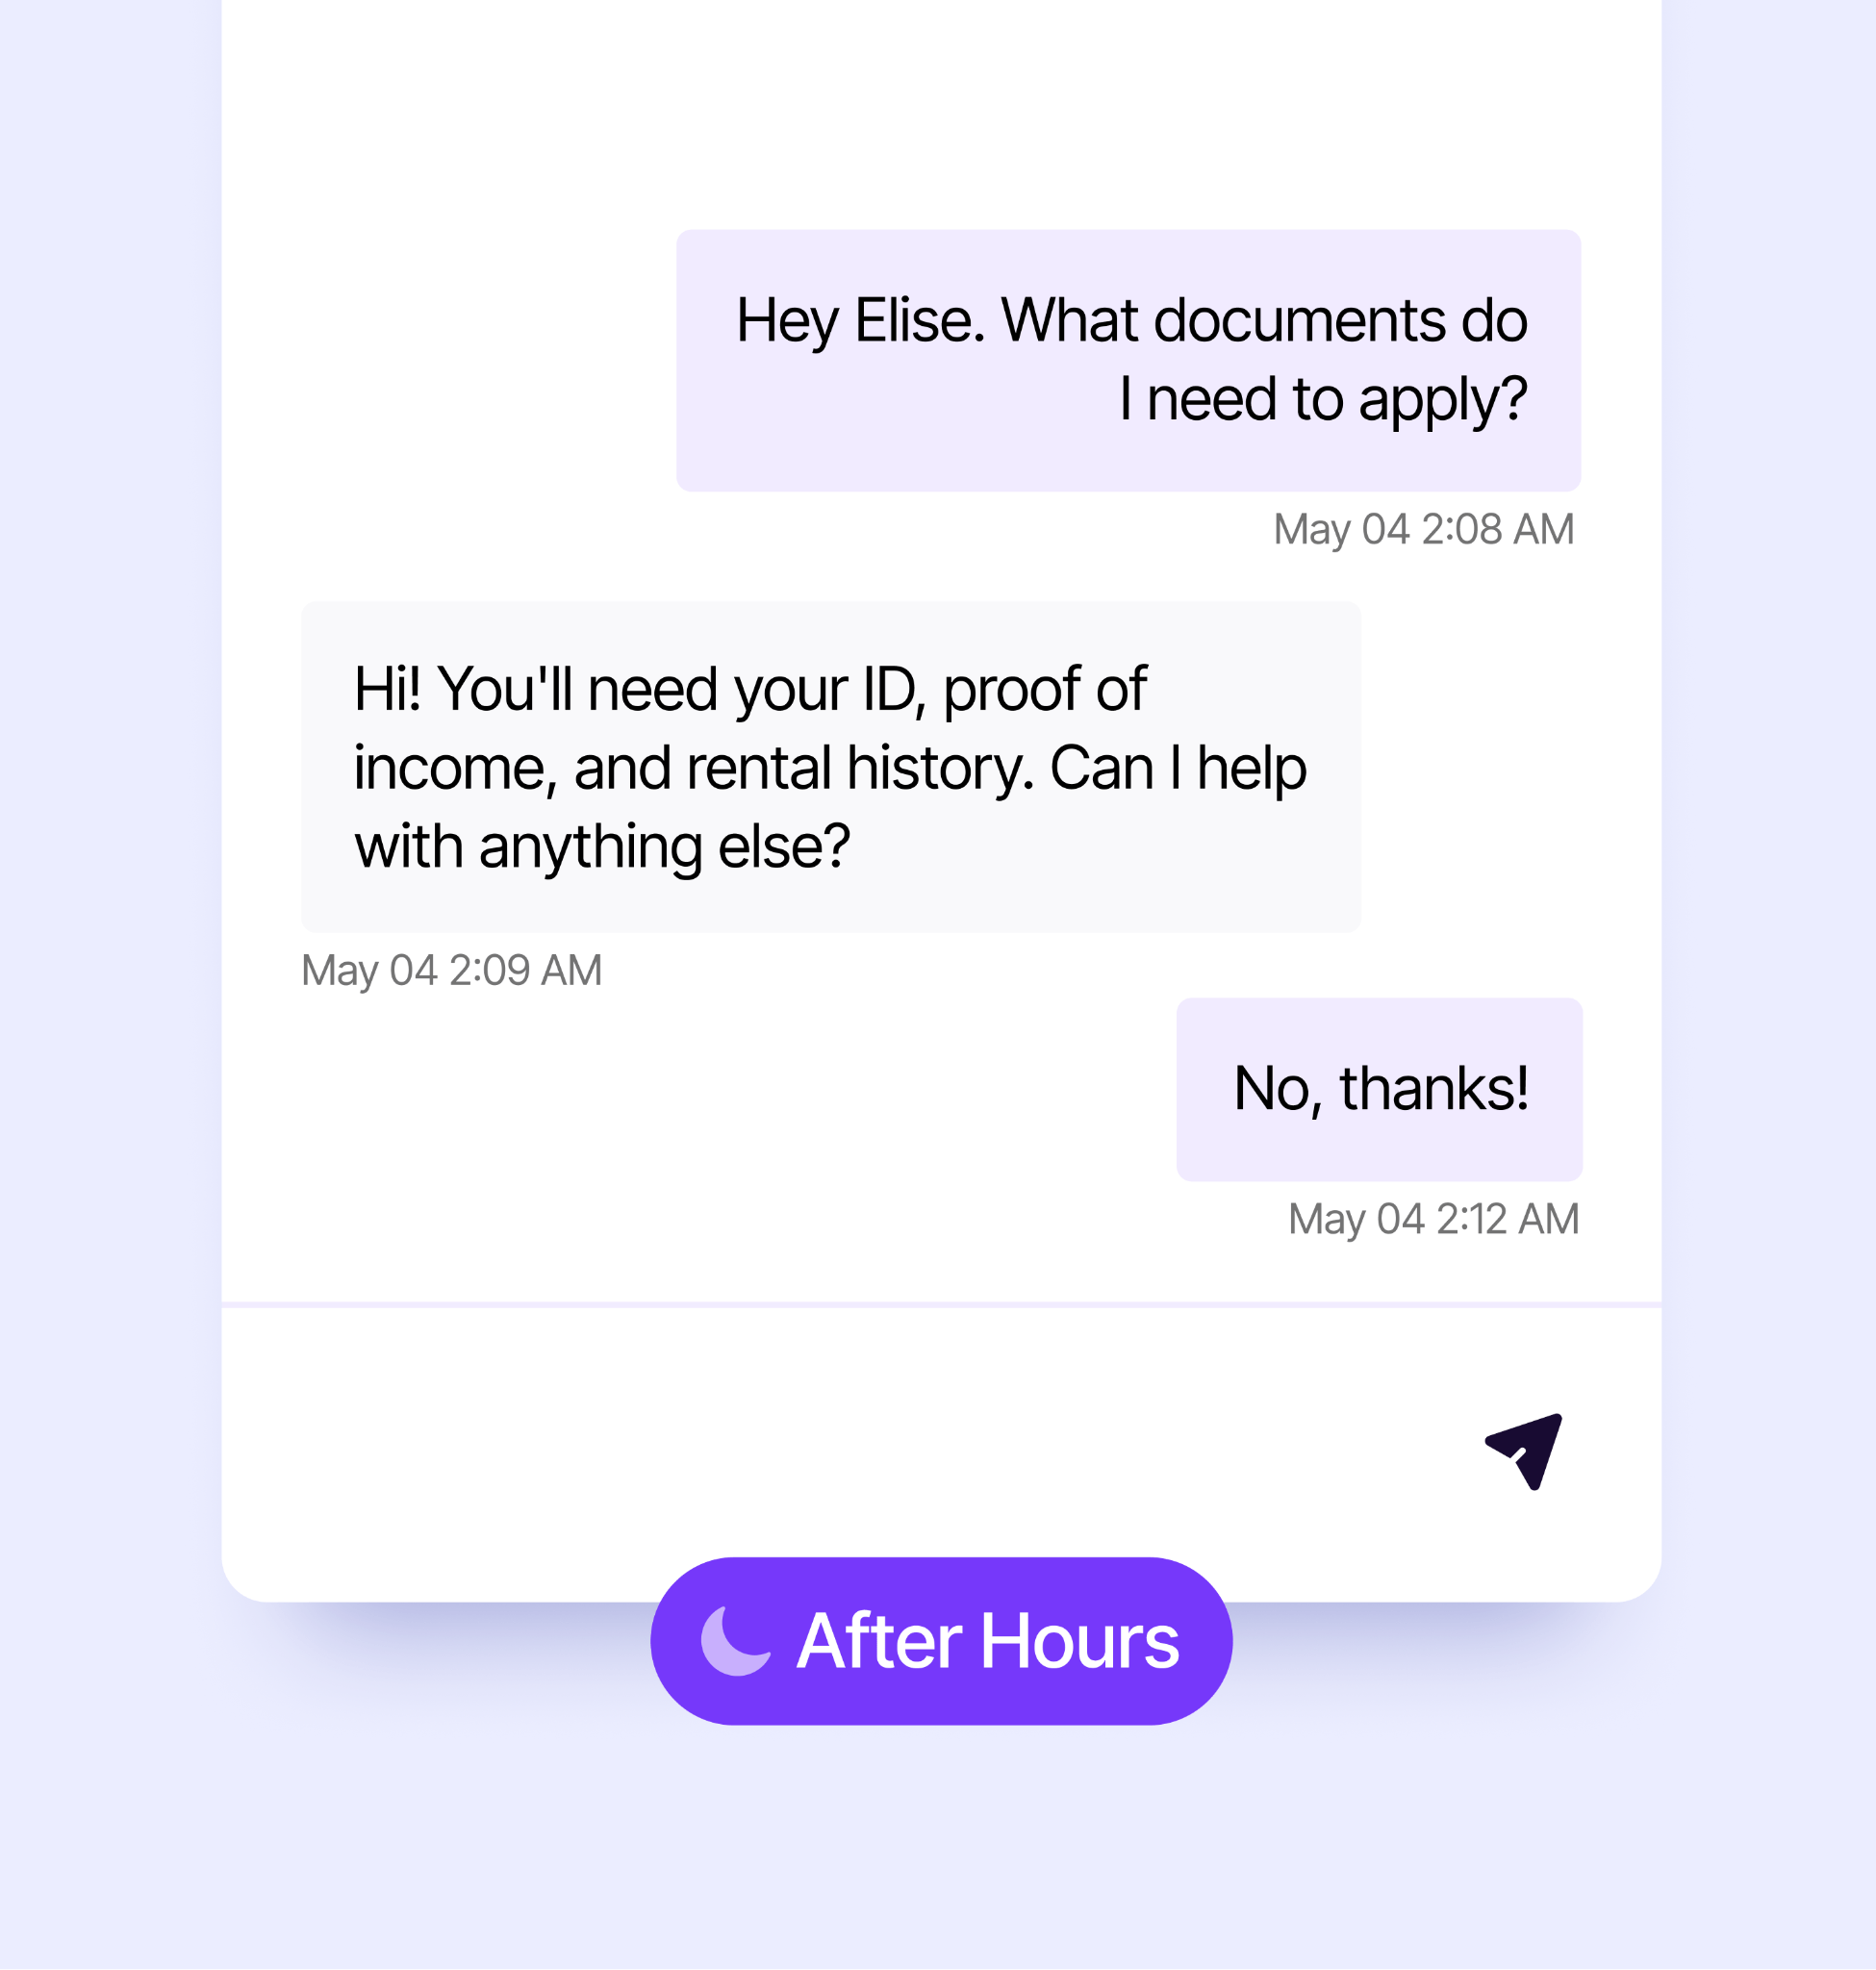
ELISEAI
LeasingAI Features
Books tours, explains amenities, answers policy questions, and suggests additional available units.
Prospect Management
Responds to all incoming prospects and keeps them engaged with consistent follow-ups and reminders.
Smart Tour Scheduling
Effortlessly schedules tours across communities, providing instructions & directions to your property’s location.
Personalized Unit Recommendations
Recommends units across your portfolio based on preferences, budget, amenities, and concessions.
24/7 Support
Manages leads after hours, logging all conversations and activity in EliseCRM ensuring all leads get followed up with.

Slide 18
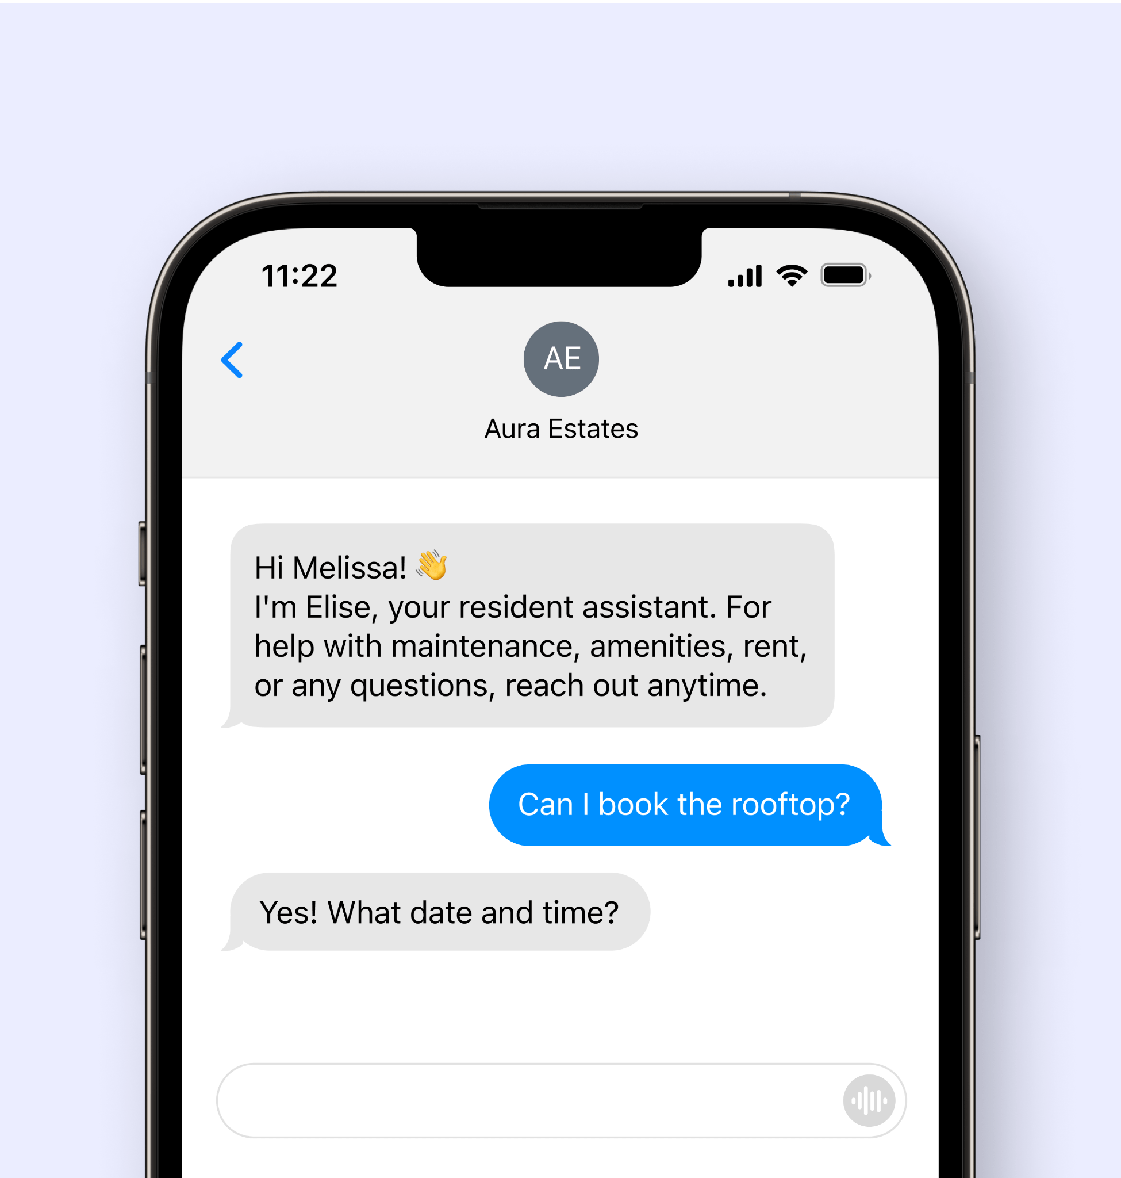
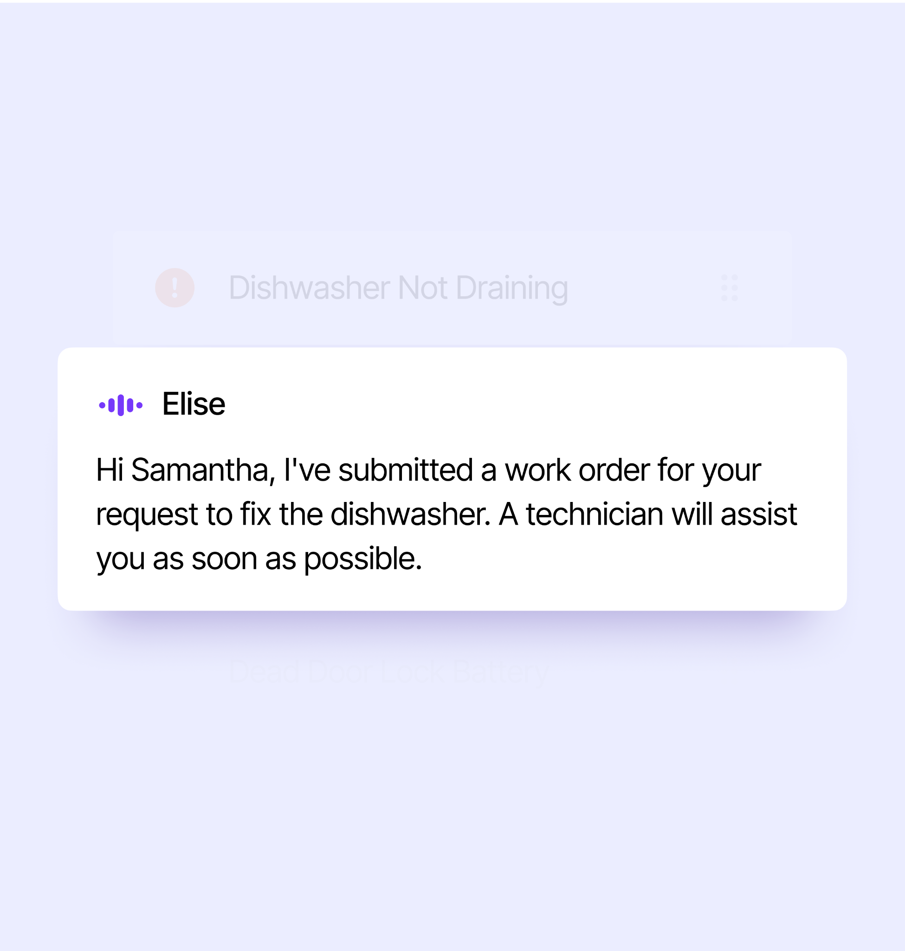
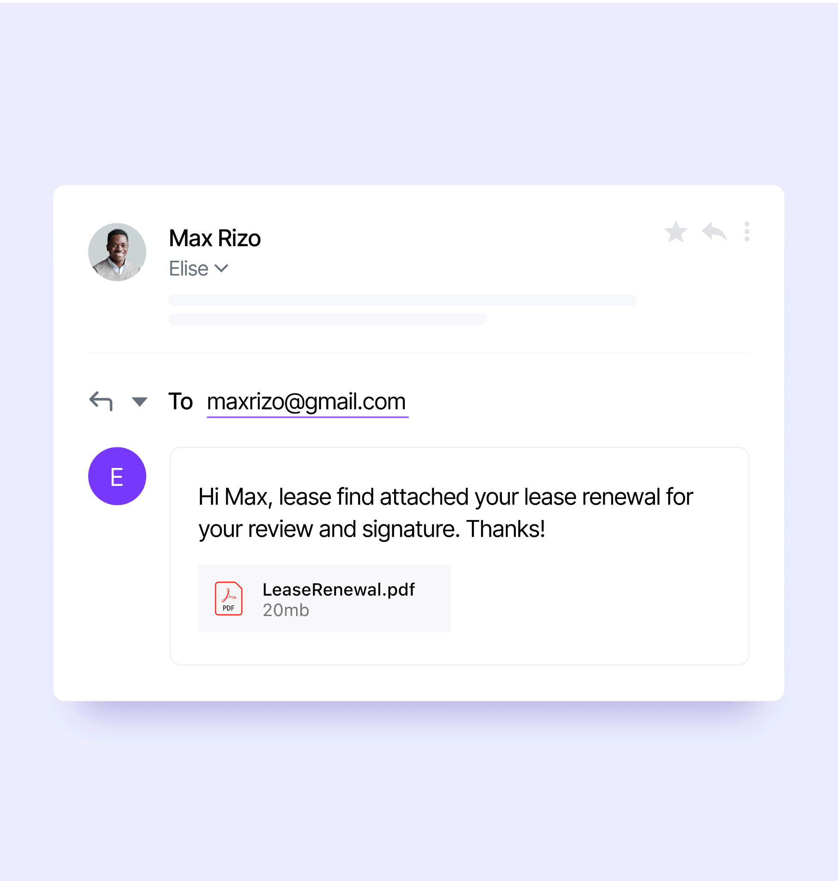
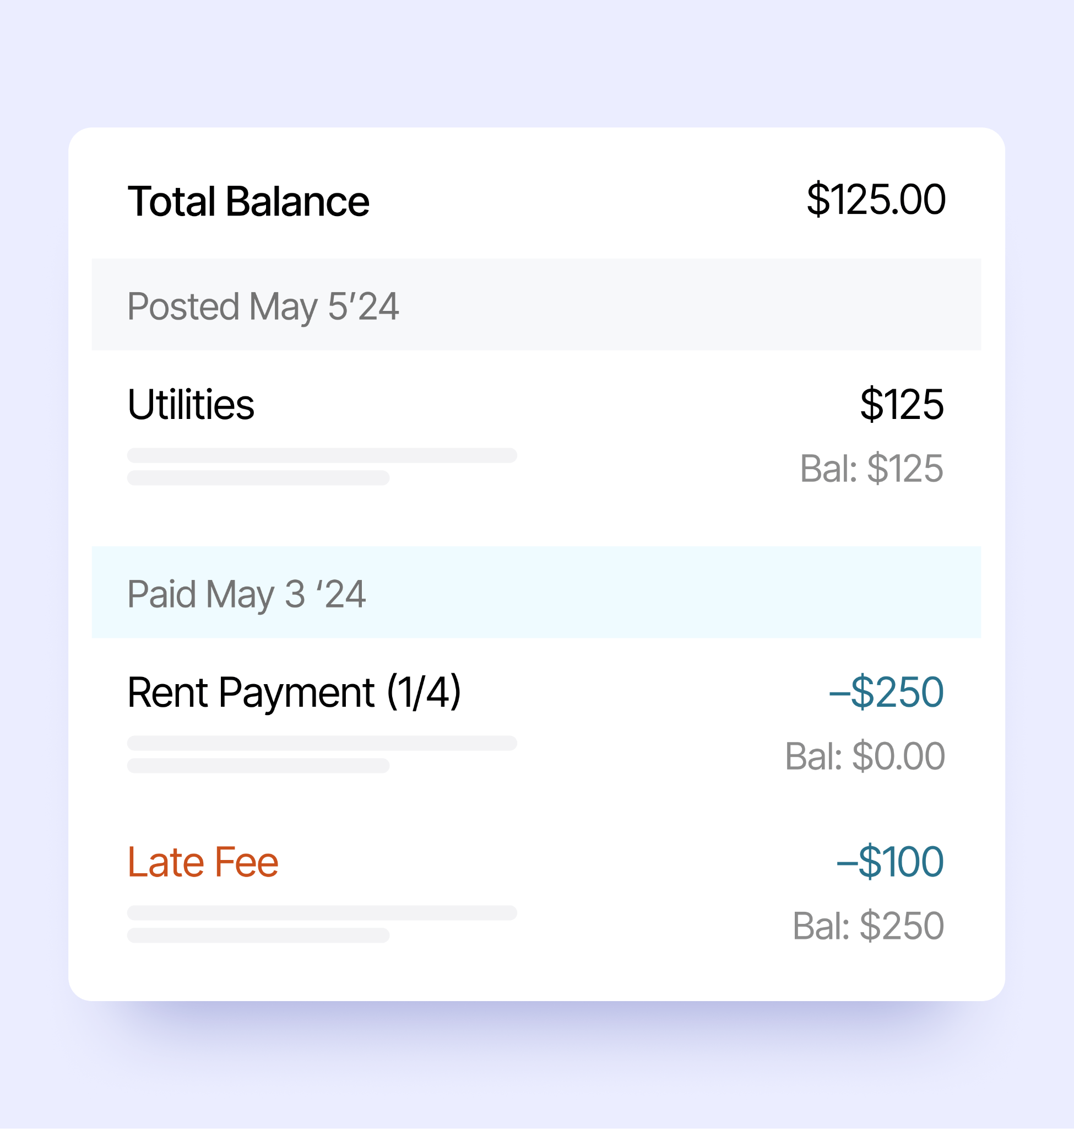
ELISEAI
ResidentAI Features
Elise logs work orders, tracks payments, sends rent reminders, and handles follow-up with your residents automatically.
Resident Concierge
Reminds renters to submit documentation, answers policy questions, and provides move-in and amenities instructions.
Maintenance
Files work orders, triages emergencies, helps renters self-service their unit, and follows up after maintenance requests.
Renewals
Automates lease renewal notifications and proactively informs renters about rent changes and deadlines.
Delinquency
Sends personalized reminders and community-specific payment instructions to current and former renters.

Slide 19
Case Study
How multifamily operators are utilizing AI to improve asset performance

Slide 20
CUSTOMER STORY
Challenges
Cardinal Group Overview
High Staff Turnover Leading to an Inconsistent Prospect Experience
Elevated Delinquency Rates
Slow Response Time to After-hour Leads
30k Units
#38
2,100
Managed by EliseAI
on NMHC Top 50
Employees
“We experience pretty high staff turnover, and that can lead to an inconsistent prospect experience.”
Jacob Kosior VP Of Centralization
“Consistency in collections has been a difficult battle across multiple sites.”
Shane Guillot Director Of Centralization
“Lead inquiries received after-hours typically do not receive a response until the following business day.”
Brady Dulling Centralized Leasing Manager

Slide 21
CUSTOMER STORY
Cardinal Group Results
Achieved new efficiencies in their operations; improved rent collection, while improving their leasing process to ensure consistent, timely follow-ups with all prospects
Automated 90% of delinquency communications
Reduced delinquency rates by 300 bps, from 7% to 4%
44% of leads coming in after-hours, 100% immediate response rate
53,331 follow-ups sent by AI, increasing lead to tour rate to 25% and lead to application rate to 7%

Slide 22
Appendix

Slide 23
Change Management
Understanding AI Capabilities
Chatbot
Your AI Assistant
Generative AI
Provides coherent, context-aware responses that keep conversations flowing.
A conversational system using generative models that enable richer dialogues.
Creates original content and identifies patterns from massive datasets.
Well defined knowledge boundaries
Tailored to specific objectives. Constantly learning.
Fewer constraints on structure or content.
AI will not replace the human touch. However, it will free you from the mundane tasks that keep onsite and centralized employees from reaching their full potential. AI will not replace you. It will empower you.

Slide 24
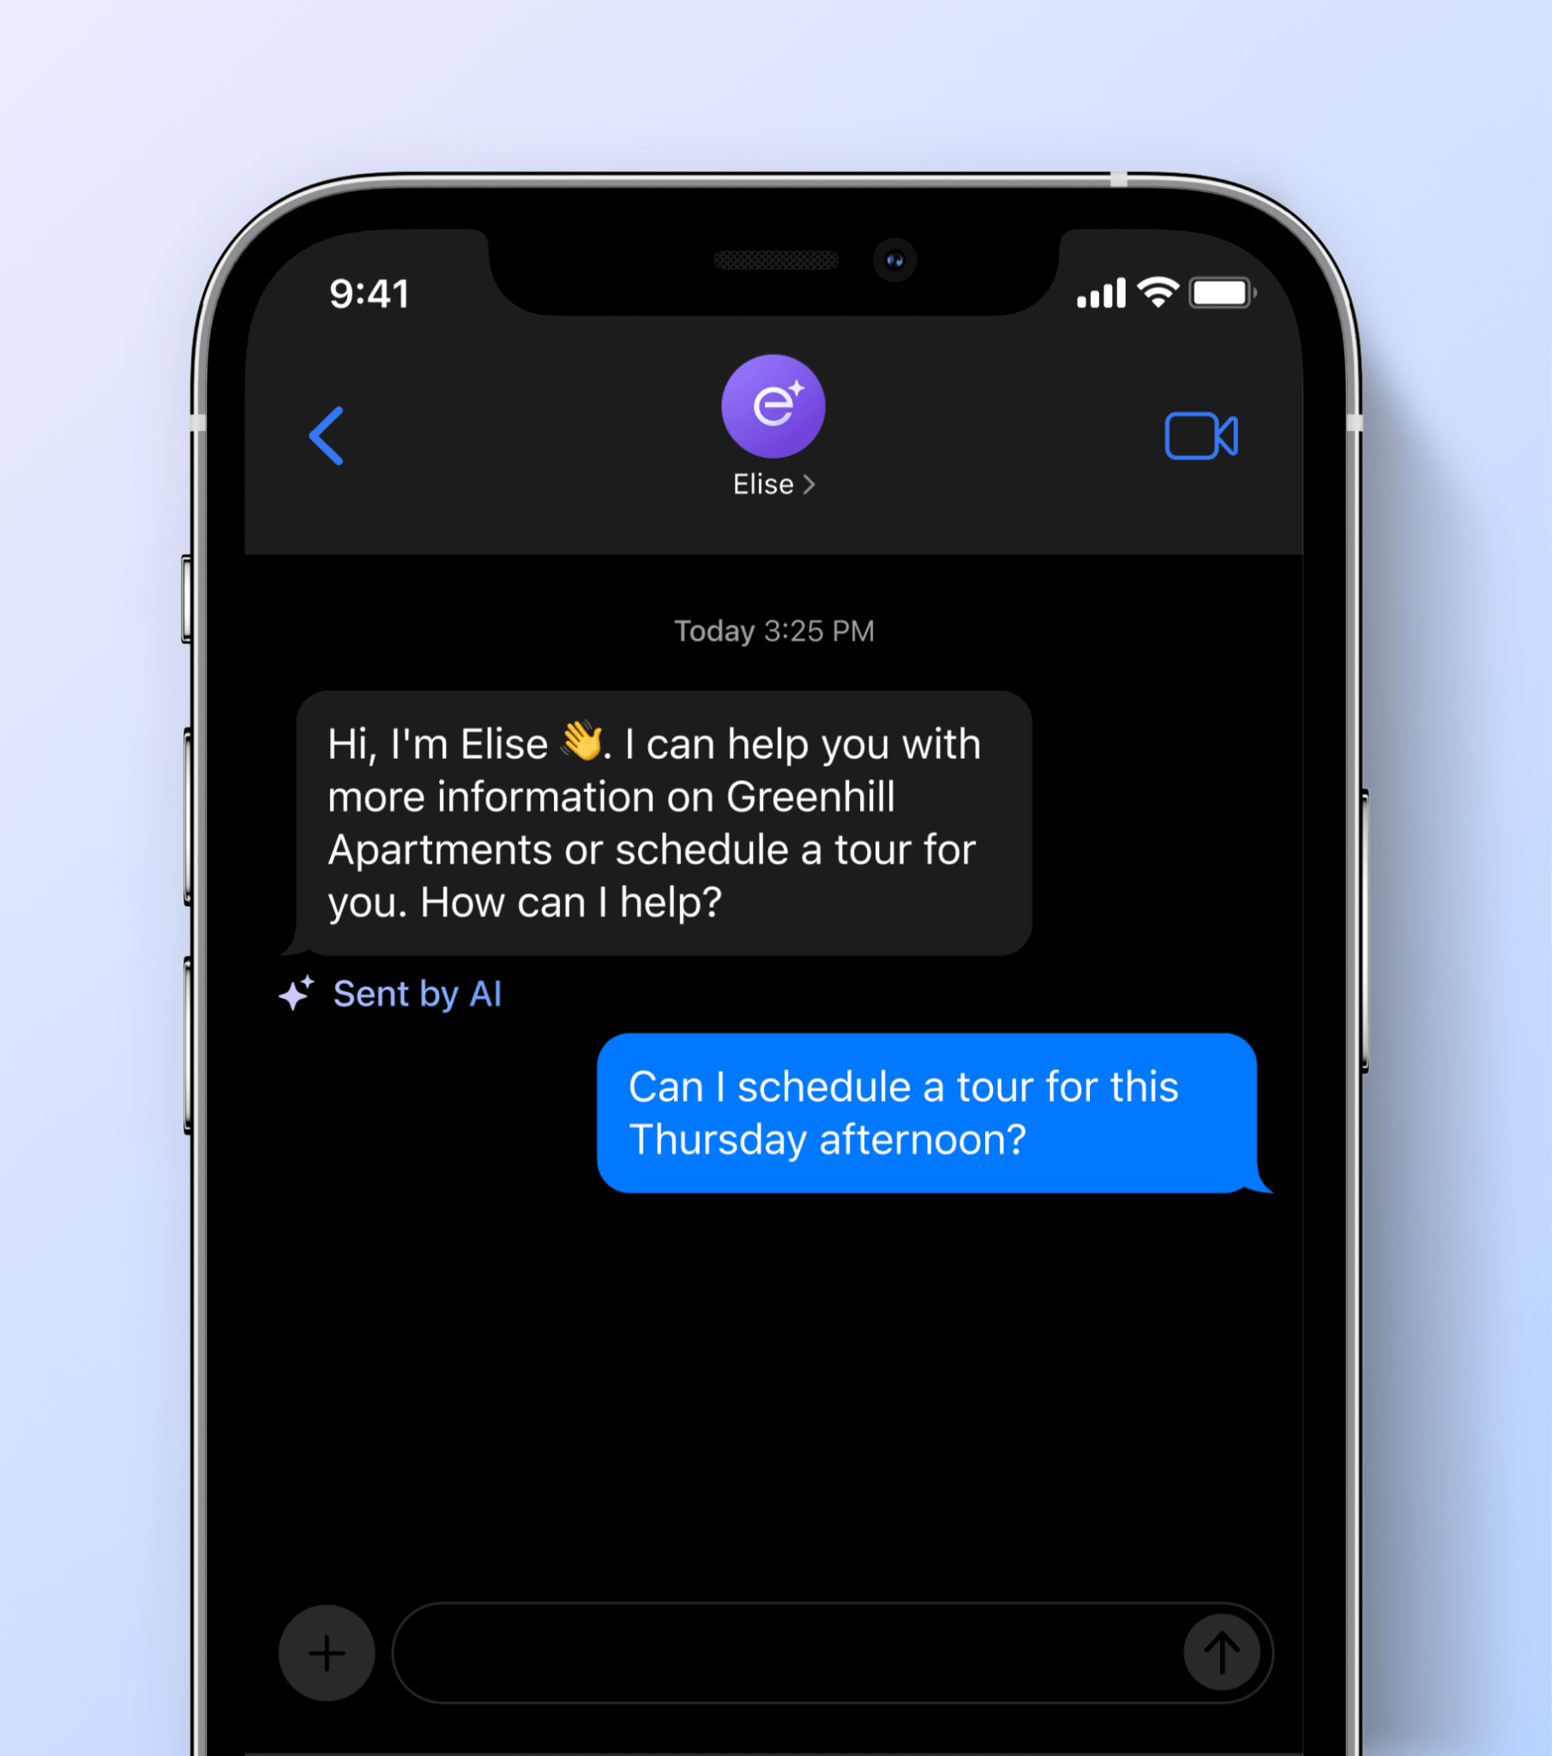
LEASINGAI
Lead Management
Your AI assistant responds to all new prospects and keeps them engaged with consistent follow-ups to match your preferred follow-up schedule.
24/7 responses across webchat, email, text, and VoiceAI AI responds within 5 minutes to keep leads warm and reduce lead unresponsiveness Answers questions about unit availability and pricing, amenities, and community guidelines Nurtures prospects during their leasing journey to keep them informed and engaged

Slide 25
LEASINGAI
Overcoming Leasing Challenges
AI-supported leasing unlocks more tours, higher quality tours, faster conversions, and ultimately, bigger leasing bonuses and happier residents.
Challenge
How AI Can Assist
After-hours calls, texts, emails, and web chats
Delayed tour follow-up messages
Overwhelming lead volume
Unqualified leads
Frequent tour cancellations
Inaccurate and inconsistent information
AI ensures 24/7 responsiveness, keeping leads warm and engaged
AI sends post-tour materials, so you can focus on the next prospect
AI serves as your scheduling assistant – no more back-and-forths
AI asks qualifying questions and routes leads intelligently
AI reminds prospects about upcoming tour commitments
AI is learning constantly and will not provide information beyond its scope

Slide 26
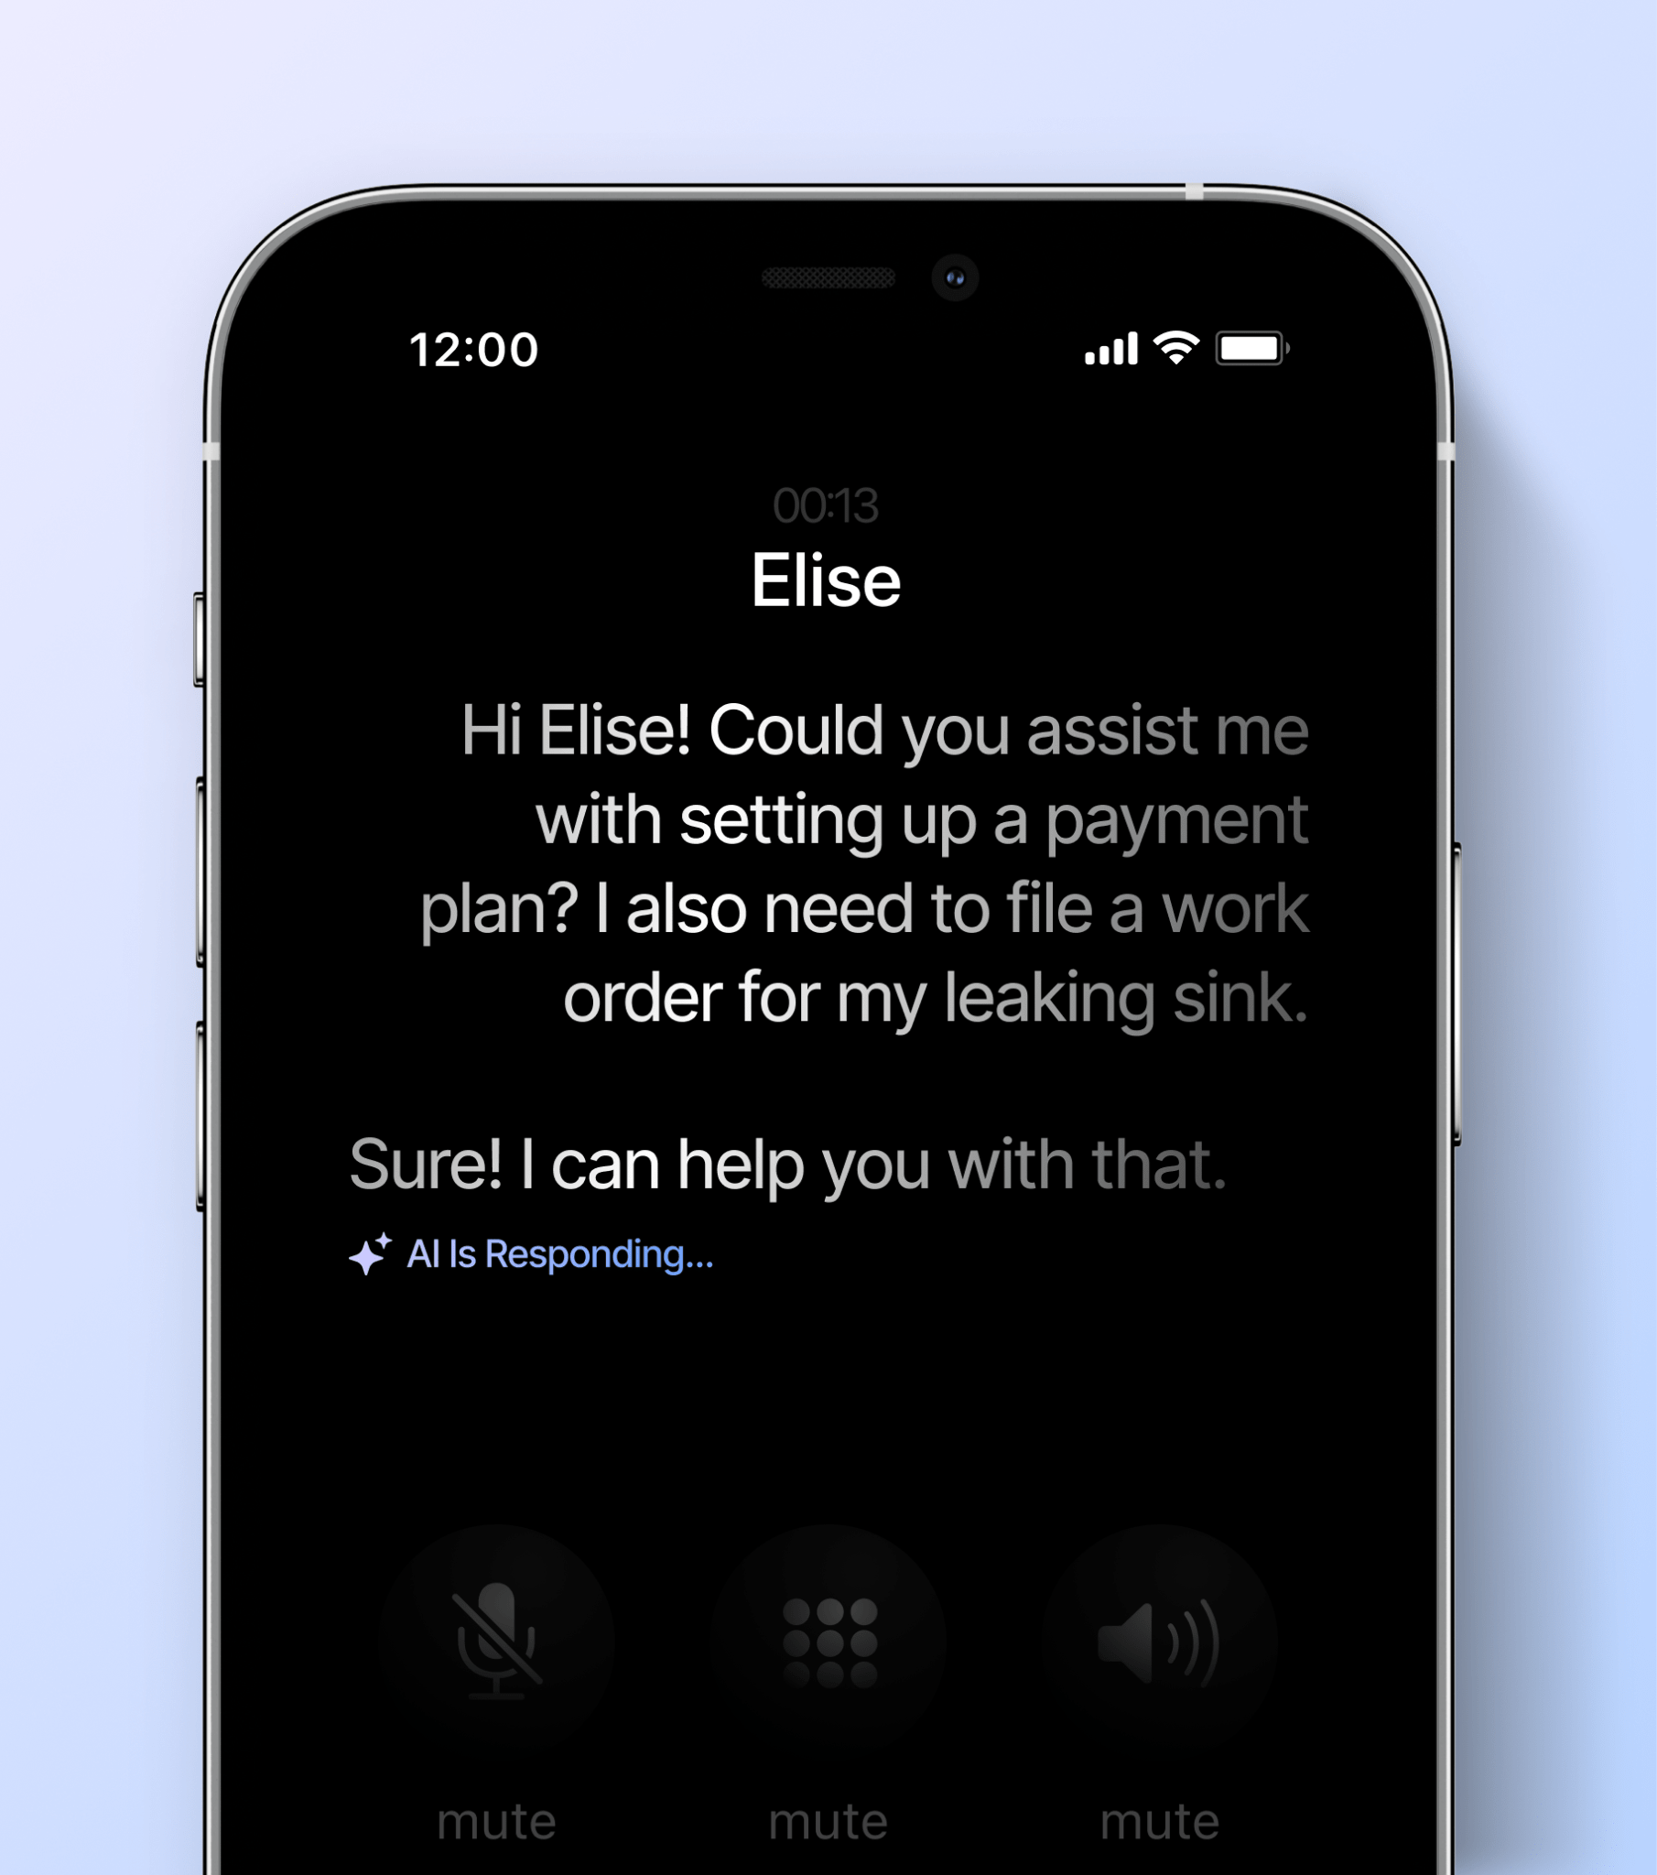
Delinquency
RESIDENTAI
AI sends personalized rent reminders and delinquency notices to current and past renters.
Custom scheduling for rent reminders and notices with conversational AI to respond to resident questions regarding their charges.
Shares ledger details via email and text message in order to proactively answer resident questions about charges.
Continues outreach on a customize schedule to reduce the need for onsite teams to follow-up with residents about their outstanding balances.
Pause communications at any time to resolve disputes or when starting the eviction process.

Slide 27
RESIDENTAI
Overcoming Collections Challenges
AI-supported collections unlocks increased collections rates, accelerated collections, greater visibility into delinquent resident interactions , and ultimately, less bad debt and fewer burnt-out AR managers.
Challenge
How AI Can Assist
Unresponsive residents carrying a balance
Inaccurate and incomplete delinquency notes
Complicated payment plan management
Improper collections protocols
AI expands your ability to send frequent, omnichannel touchpoints
AI saves a record of every phone, text, email, and chat conversation
AI makes it easy to set up payment plans and handles reminders
AI scores calls to ensure agents are not violating SOPs

Slide 28
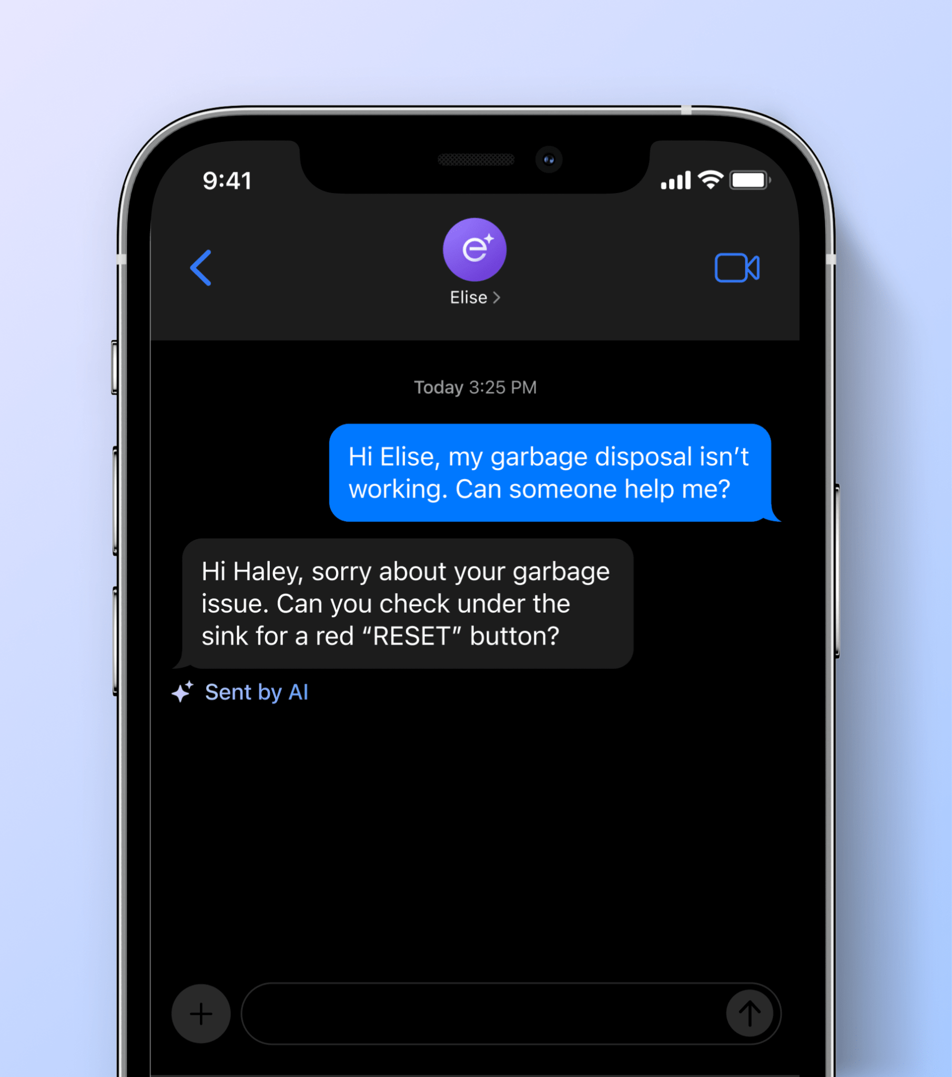
RESIDENTAI
Maintenance
AI tool that submits work orders, triages emergencies, helps residents self-service their unit, and follows up when a work order is completed.
Prospects can simply text, email, or call to easily file a work order. Asks for more details over the phone/SMS for comprehensive work order tickets. Prompts resident with DIY steps if the maintenance request can be troubleshooted in real-time. Routes calls to the right team based on pre-selected emergency contacts and de-escalates “non-emergency” requests.

Slide 29
RESIDENTAI
Overcoming Maintenance Challenges
AI-supported maintenance unlocks quicker ticket resolution, fewer costly escalations, simplified scheduling, and ultimately, happier residents. It also reduces after-hours property visits and the associated overtime burden.
Challenge
How AI Can Assist
Costly escalations and overtime burden
Incomplete information about work orders
Scheduling headaches and PTE issues
Uncaptured resident sentiment
AI follows de-escalation flows before routing tickets intelligently
AI asks the right questions and collects relevant information and photos
AI serves as your scheduling assistant – no more back-and-forths
AI prompts reviews after detecting positive feedback

Slide 30
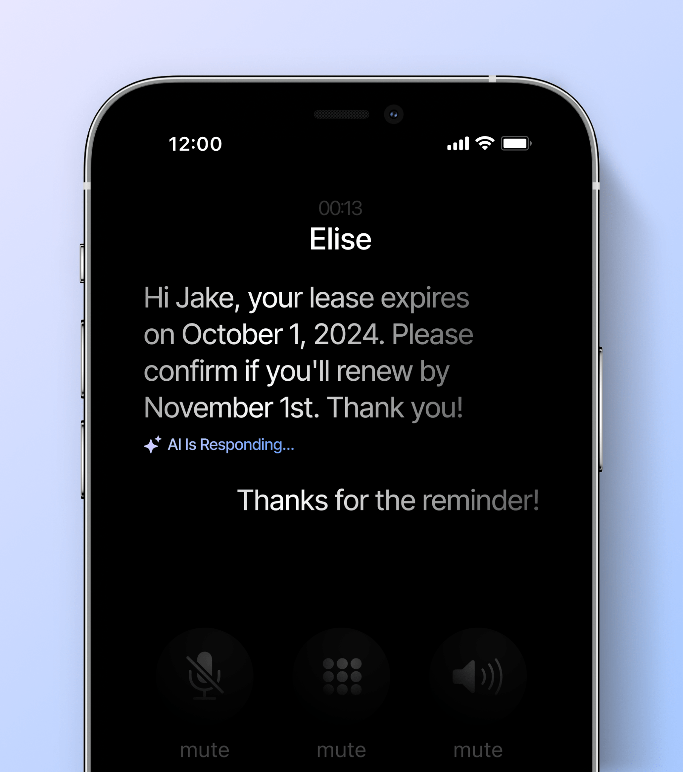
RESIDENTAI
Renewals
Automate your lease renewal notifications, send reminders, and proactively inform renters about rent changes and deadlines.
Customize your renewal touch-points while keeping detailed records of resident feedback and sentiment. 4-6 months ahead of renewal, your AI assistant will ask tenants whether they are looking to renew and gather reasons for not renewing. Proactively discuss renewals over the phone if the resident is calling in about anything else (additional authentication required).

Slide 31
RENEWALS
Predicting Likeliness to Renew
Your AI assistant documents all resident interactions and uses these records to inform renewal outreach efforts
Unit A7 • 1bd 1ba
Chloe Robinson
Unit B17 • 2bd 2ba
Paul Highland
Unit C20 • 2bd 1ba
Melissa Meadows
Lease End Date: Oct 1, 2024
Rent: $1,000
Resident History
Generally pays rent on time
Submitted 5 work orders, provided positive feedback
Likely to renew
Lease End Date: Nov 15, 2024
Rent: $3,000
Resident History
Late rent payment 2 times
Submitted 15 work orders
Submitted 3 noise complaints
Not likely to renew
possibly moving for new job
Lease End Date: Nov 20, 2024
Rent: $2,500
Resident History
Pays rent on time
Submitted 3 work orders
Asked about transferring to a
higher floor
Likely to renew

Slide 32
RESIDENTAI
Overcoming Renewals Challenges
AI-supported renewals unlocks a smoother renewal process, more complete resident sentiment information, and more time to foster the relationships that make renewing an easy decision.
Challenge
How AI Can Assist
Adherence to renewal touchpoint schedule
Incomplete information about renewal
Unresponsive residents
Frequent renewals escalations
AI follows your preset renewal follow-up cadence
AI provides detailed transcripts and summarizes all renewal interactions
AI provides an omnichannel outreach solution
AI reduces the likelihood of missed deadlines and unwanted surprises

